Slide 1
Going behind the scenes
Understanding and organizing a corporate fitness center

Slide 2
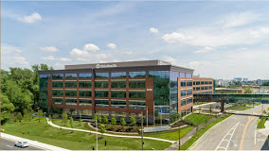
Ohiohealth & employer services
Lauren Quintana, MS
Corporate Fitness Manager, Employer Services
OhioHealth David P. Blom Administrative Campus
Various OhioHealth corporate fitness centers

Slide 3
Employer services overview
Notes:
Directors – 7-8 within employer services
Managers -

Slide 4
Ohiohealth corporate fitness
Director of Corporate Fitness – Amy Upp
Corporate Fitness Manager – Lauren Quintana
Wellness Coordinator
Exercise Physiologists
Group Fitness Instructors
Outpatient Dietitians
Supervisors
Front Desk reception
Notes:
These over here are the all-time on-site fitness staff (although EPs and outpatient dietitians attend health fairs and with some contracts are sent out to certain events with c

Slide 5
Corporate fitness offerings
Wellness Programs
Group based coaching
Nutrition consultations
Lunch & Learns
Fitness
Wellbeing
Fitness Offerings
Yoga
HIIT
Inbody Testing
Fitness Management
Health Fairs
Health coaching
Nutrition
Zumba
Pre and Post Assessments
Corporate Membership
Staffing
Management

Slide 6
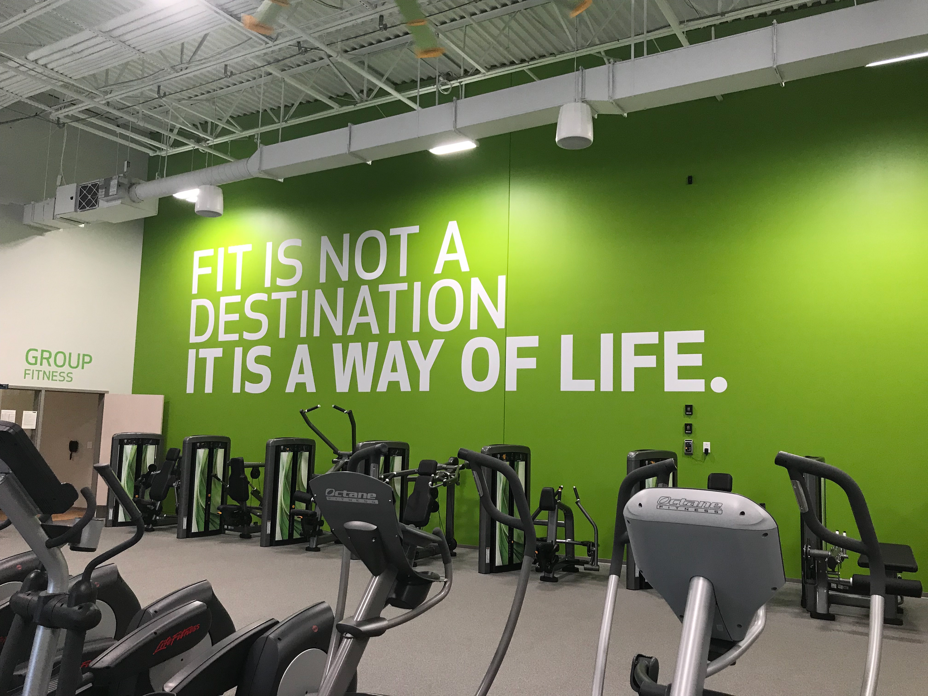
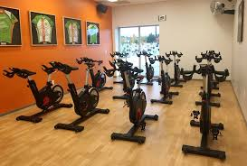
Huntington national bank fitness centers
Gateway
8,000 sq. Ft.
Membership – 400+
Easton
9,000 sq. Ft.
Membership – 700+
Akron
5,000 sq. Ft.
Membership – 200+
Available population – 1,300
58%
Available pop. - 2,600
65%
Available pop. - 550
70%
Notes:
With all facilities having a retention rate of 98% or greater

Slide 7
HNB Data Reports
Needs
Meeting
Action Steps
Action
Track:
PMPM
PMPY
% of members with 2 visits/week
Cross reference with Gateway Wellness (utilization)

Slide 8
Cultivating relationships
Business Development
Business Liason
Leads meetings
Main mediator between business and OhioHealth
Weekly/Bi-weekly meetings
Monthly/Yearly programs
Goals & Objectives

Slide 9
Fitness Programming
Upcoming Fitness programming
Huntington Total Health
Fitness and Wellness collaboration
Next year programming
Additional needs and wants from HNB
Notes:
Fitness programming led by supervisor or Lauren
Upcoming – scheduling (new group fitness schedules, what is available to who
Programs on-site Fall fitness week – open to all colleagues,
Weigh to Go - more specific programs only to members, cost $65 (covers materials handed out, cost of dietitian visit)

Slide 10
Opportunity for new site
BMW Call Center
Liason – Tricia
Site visit
Fitness Facility
Wellness Clinic
Additional space available for use
What are their wants and needs?
Notes:
Tricia discuss with BMW what they're looking for she will invite the necessary people along for site visit
Talk about site visit – current situation, hours, group fitness
Sat and discussed what they're looking for – opportunities for colleagues at their desk, short periods throughout the day, a staffed fitness area, more coached programs

Slide 11
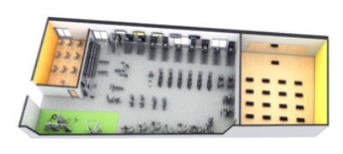
Floor Plan for size reference

Slide 12
Site review for bmw
~1,500-1,600 colleagues in building
Not currently staffed
Badge-in access/Sign in
Locker room – across from fitness area
No organization of fitness equipment
Outdated/worn equipment
Low utilization

Slide 13
recommendations
Membership
Payroll deducted
Lower cost for membership
Staffing/Space
1 EP on site
Possible 1 front desk/reception staff
Programs
Increase # of group fitness classes
10 minute stretch breaks
Offer sign-up incentives
Lunch & Learns
Communication through member e-mail
Update equipment/review cardio equipment
Re-work layout

Slide 14
Program calendar
January | February | March | April | May | June | July | August | September | October | November | December
Fitness 101 QuarterlyChallenge |  | March Mayhem | Quarterly Challenge | Mindfulness / Meditation |  | Women's Wellness Quarterly Challenge |  | Weight Program | Quarterly Challenge | Holiday Holdout
Wellbeing Webinar | Lunch & Learn |  | Lunch& Learn |  | Wellbeing Webinar |  | Lunch & Learn | Wellbeing Webinar | Lunch & Learn |  | Lunch & Learn
Miscellaneous: Continuous 10 minute stretch breaks, department wide stretch breaks, 10 minute walks, quarterly satisfaction surveys
Notes:
Taking into consideration of what theyre looking for and their

Slide 15
Group Fitness calendar
Monday | Zumba
 | 10 min Legs
 | HIIT
 | 10 minute Walk
 | Barre
Tuesday | Built on Balance
 | 10 minute
 | Pilates
 | 10 minute
 | Strength and Mobility
Wednesday | Yoga
 | 10 minute
 | Strongstep
 | 10 minute
 | Total Body
GROUP
FITNESS SCHEDULE
Notes:
Quarterly – keep things new and fresh – obviously limited as to space and amount of equipment
Utilize Zumba, Barre, HIIT
At huntingotn currently around 20-30 group fitness classes a week
Suggest starting smaller to understand times and amount of people
Track number of people

Slide 16
BUDGETING AND FINANCES
Determine how much BMW is wanting to spend on upgrades/remodeling/equipment
How much staff are they budgeting for?
Expenses including bringing in dietitians/therapists
Can other companies compete with our services/offerings?

Slide 17
Next steps
Bring BMW on site to view offerings in person
Work closely with OhioHealth Wellness to ensure our goals and objectives align
Draft proposal
Develop timeline

Slide 18
QUESTIONS?

