Slide 1
My healthcare administration experience at lifecare alliance
By Ayat Al Jbour

Slide 2
Lifecare alliance
My practicum site was LifeCare Alliance
“Nourishing the Human Spirits”
LifeCare Alliance is a not-for-profit organization that provides a comprehensive array of health and nutrition services to residents of Central Ohio
It was founded in 1898 as the Instructive District Nursing Association (IDNA), LifeCare Alliance was Columbus’ first in-home health care agency and Ohio’s first Visiting Nurse Association

Slide 4
Lifecare alliance programs and services:
Meals on Wheels
Columbus Cancer Clinic
Central Ohio Diabetes Association
Carries Caffe and Dining Canter
Help at Home
Wellness
Project Openhand Columbus
Senior Petcare
Impact safety
Visiting Nurses
Refer a Clients

Slide 5
Wellness department
LifeCare Alliance Wellness Centers provide specialized wellness assistance for adults throughout Franklin County.
The program offers low-cost, high-quality health services, each Community Wellness Center is staffed with a registered nurse and a registered dietitian, providing expertise in foot care, health assessments, and disease prevention and management.
Nurses and dietitians work with clients to monitor and maintain good health.

Slide 6
Wellness department provides
Biometric screening and this services are done by Registered Dietitian
Immunization vaccines including Hepatitis A & B, Influenzas, travel Vaccines, Tdap, MMR.
In Flu season Wellness departments run a lots of Flu Clinics which starts from the beginning of September to the end of November
Most of flu clinics are held in the patients working sites or colleges. Or by setting up an appointment with one of the Nurses in the office

Slide 7
My role at the wellness department of LifeCare Alliance
I was working in fall flu immunization program.
Helping with documentation collection of insurance info, personal identification
Assisting nurse with administrative duties
working in electronic health records for documentation and billing purposes
working in the community at flu clinics to assist in the running of the clinic
Other assignments needed in the wellness department from organizing patients' files and help with office work

Slide 8
Mobile Flu clinics
How to prepare for a mobile flu clinic?
Clerk and the nurse are both responsible for preparing and running the flu clinic, here's the basic steps that I have been doing through my practicum at the Wellness department
Using packing sheet list to pack all clerical supplies and medical supplies
Then the Nurse is going to check the list again and make sure that everything
the clinic is going to need is packed and ready to go, including:
Consent forms
Vaccine information sheets
Payment receipt
Pens
Flu shot stickers
Reconciliation forms
Signs ( Injection site), (please show your Id and insurance cards)

Slide 9
Cont..
The Nurse procedure book
Sharps containers for used vaccines and needles
Vaccines
Medical box supplies Contains alcohol swab, liquids hand sanitizer, cottons balls, band aids, 1” needles and 11/2 needles.
Gloves
Bio bags and trash bags
privacy screens
Lab tops and scanners if needed

Slide 10
3. Setting up the place to start the clinic
4. Making sure about having the correct personal information for each patient, getting copies of their insurance and ID cards.
5. At the end of the clinic, we go back to the Wellness department.
6. Start working on electronic health records to enter the patient's data to the system for billing purposes.
Working on EHR could take a lot of effort and time. Due to the numbers of patients. Especially in the fall season.
The patient numbers could range from 50 to 100 every week.

Slide 11
Other experiences
I had the chance to be a part of a donation process, where people donate to LifeCare Alliance some type of supplies that could help another patient. For examples: wheelchairs, medical supplies.
Attending an education workshop that was held at LCA, the presentation title was Communicating Bad News. It was basically talking about how healthcare physicians should learn to deliver bad news to their patients and families.

Slide 12
I Went to the Ohio Alliance for Innovation in Population Health meeting, which is an integrated, multi-sector initiative created to implement the State Health Improvement plan.
The meeting has a group of experts of the state’s universities, researchers, hospital association, healthcare providers, and public health experts.
This program was created by Ohio University College of Health Sciences and professions, and The University of Toledo College of Health.
LifeCare Alliance is going to collaborate with The Ohio Alliance program as a healthcare provider for Nutrition 101 project
LCA is going to recruit Social workers to visit patient home to see if they are eligible for the project services

Slide 13
Seniors Dining centers
I went to explore Harmon center or the Seniors dining center. This center is open to people aged 60 or over and provides nutritious meals daily. Sometimes they offer a free transportation too.
This center is also the same building where LCA prepares meals for meals on wheels program. This building is also having the food pantry, dining room, and the kitchen.
Senior Dining Centers are located throughout Franklin, Madison, Marion, Champaign, and Logan counties.

Slide 14
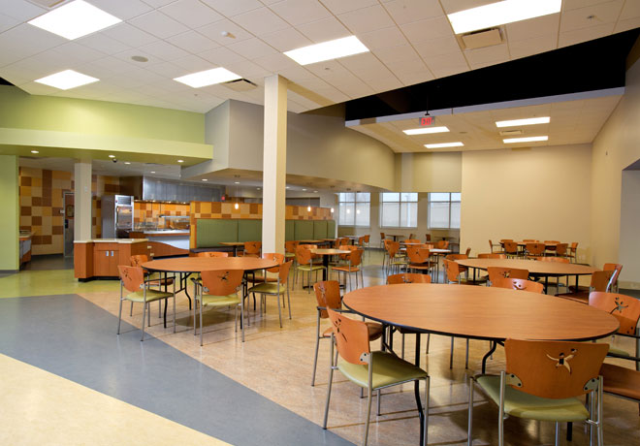

Slide 15
Columbus Cancer Clinic
My recent experience at LCA is working with Columbus Cancer Clinic, they offer multiple services including:
Breast Mammography test
Free transportation
Interpretation services for more than 200 languages
Homecare support program and food pantry for people battling cancer
They also have wigs and general healthcare supplies for anyone battling cancer who needs them.
I got the chance to get involved and work on Electronic Health Records to enter patient's data.

Slide 16
Servant Leadership
A servant leader demonstrates the following behaviors:
Focuses on the needs of followers
Eschews selfish behavior, personal biases, and pursuit of personal ambition
Sincerely respect all people
Realizes that the contributions of followers are what enable the organization to fulfill its mission
Helps, encourages, and counsels followers to hone their skills and become better at their positions because of doing so brings the organization closer to its goals.
Leadership in healthcare: essential values and skills
Carson Dye - Health Administration Press - 2017

Slide 17
Leadership in healthcare
There's some way that a leader can show respect to his work team:
Become a collaborator
Collaboration is a great companion for people who have different strategies or priorities, but they still share the same goal.
Collaboration could help in
increase a leader achievement
combine expertise, experience, and recourses
Minimize or prevent mistakes and waste in effort, time, and money
Produce better product or services
Leadership in healthcare: essential values and skills
Carson Dye - Health Administration Press - 2017

Slide 18
Be aware of Others’ Definition of Respect
Because everyone has his own perspective about respect.
Establish a Feedback System
A successful leader should have the ability to establish a feedback system with the staff, this could improve the relationship between the team leader and his members.
Be Genuine
By being visibly involved in organizational activities.
Give Credit and Acknowledge Accomplishments

Slide 19
Offering help or coaching
Be self-aware
Take responsibility for mistakes and apologize
Learn the principles of affirmation
Show appreciation
Show enthusiasm

Slide 20
The Benefits of LCA practicum Experience
Acquire HealthCare Administration experience
Networking
During my practicum I got the chance to work with a variety of professionals, experts. Each of these connections is important in working sites.
Gain new knowledge
I became more actively engaged in the field. Instead of just learning concepts and theories in class, I was able to relate my knowledge to work.
Develop New Skills
I was able to see how organization deal with their problem, and what they do to find solutions.

Slide 21
Any Questions?

Slide 22
Thank You!

Slide 23
References
History " Lifecare Alliance
https://www.lifecarealliance.org/about/history
Community Partner Spotlight: Lifecare Alliance
Susan Columbus - https://komencolumbus.wordpress.com/2018/03/05/community-partner-spotlight-lifecare-alliance/
Leadership in healthcare: essential values and skills
Carson Dye - Health Administration Press - 2017

