Slide 1
The Holistic Development of Student-Athletes at Otterbein University
Bryant McKnight

Slide 2
Goals
1. Create a curriculum to better equip coaches, especially graduate assistants (GA), to successfully recruit student athletes.
2. Improvement of the Student-Athlete (S-A) Mentorship Program
3. Create knowledge for increasing scholarship opportunities
4. Explore college athletics outside of Otterbein University.
5. Develop a healthy living program for coaches at Otterbein

Slide 3
Recruiting
Any solicitation of prospective student-athletes or their parents by an institutional staff member or by a representative of the institution’s athletics interests for the purpose of securing a prospective student-athlete’s enrollment and ultimate participation in the institution’s intercollegiate athletics program (NCAA, 2018)

Slide 4
Recruiting
My Experience

Slide 5
Literature on Recruiting
Survey shows that Division I athletes had six factors that helped them decide which school to choose during recruitment process: 1. Major 2. Head Coach 3. Career Opportunities after graduation 4. Social Atmosphere of the team 5. Amount of Financial Scholarship 6. Academic program reputation. (Kankey, 2007)
Study which looked at difference among Division I, II and III Lacrosse players in which schools they choose. Biggest factors were: Scholarship, athletic team, team atmosphere, academic major and Location (Pauline, 2010)
Location and proximity to home were the biggest factors in a study conducted amongst Division I football players (Dumond et al., 2008).
Research done in 2012 suggests that opportunity to play immediately, scholarships given and professional opportunities after college were bigger deciding factors than facilities (Schneider, 2012)

Slide 6
NCAA GOALS (Growth, Opportunity, Aspirations and Learning of Students in College) Every 5 Years Topics such as: Academic, Athletic & Social Experience Recruitment & Health and Well-Being

Slide 7
NCAA GOALS cont.

Slide 8
Recruiting
"Recruiting is critical for any Division III athletics program. And recruiting student-athletes is critical for any Division III institution." (NCAA, 2018)
Approximately 20-30% of students at Division III Institutions are student-athletes (NCAA, 2018)
A 2013 survey showed that recruiting has increased as a key component of enrollment strategies, 61% in 2008 to 71% in 2013 (NCAA, 2018)
There are approximately 8,000 NCAA Division III teams, representing some 60,000 student athletes, with 2 out of 3 student-athletes being actively recruited to their institution. The other 1/3 of athletes where recruited after being enrolled in the university.

Slide 9
Recruiting
Goals:
Create curriculum to help coaches, especially GA's recruit better
Create knowledge of increasing scholarship opportunities
Explore universities outside of Otterbein.

Slide 10
Recruiting
Awareness for Scholarship Opportunities
Interviews with coaches to discuss best practices and how they utilize GA's
C. Tool Box

Slide 11
A. Awareness for Scholarship Opportunities
What Scholarships are available to student-athletes?
Opportunity Scholarship
Urban Initiative Scholarship
How can we utilize these more on the recruiting trail?
How do we make Information available to coaches/administrators/prospective student-athletes?

Slide 12
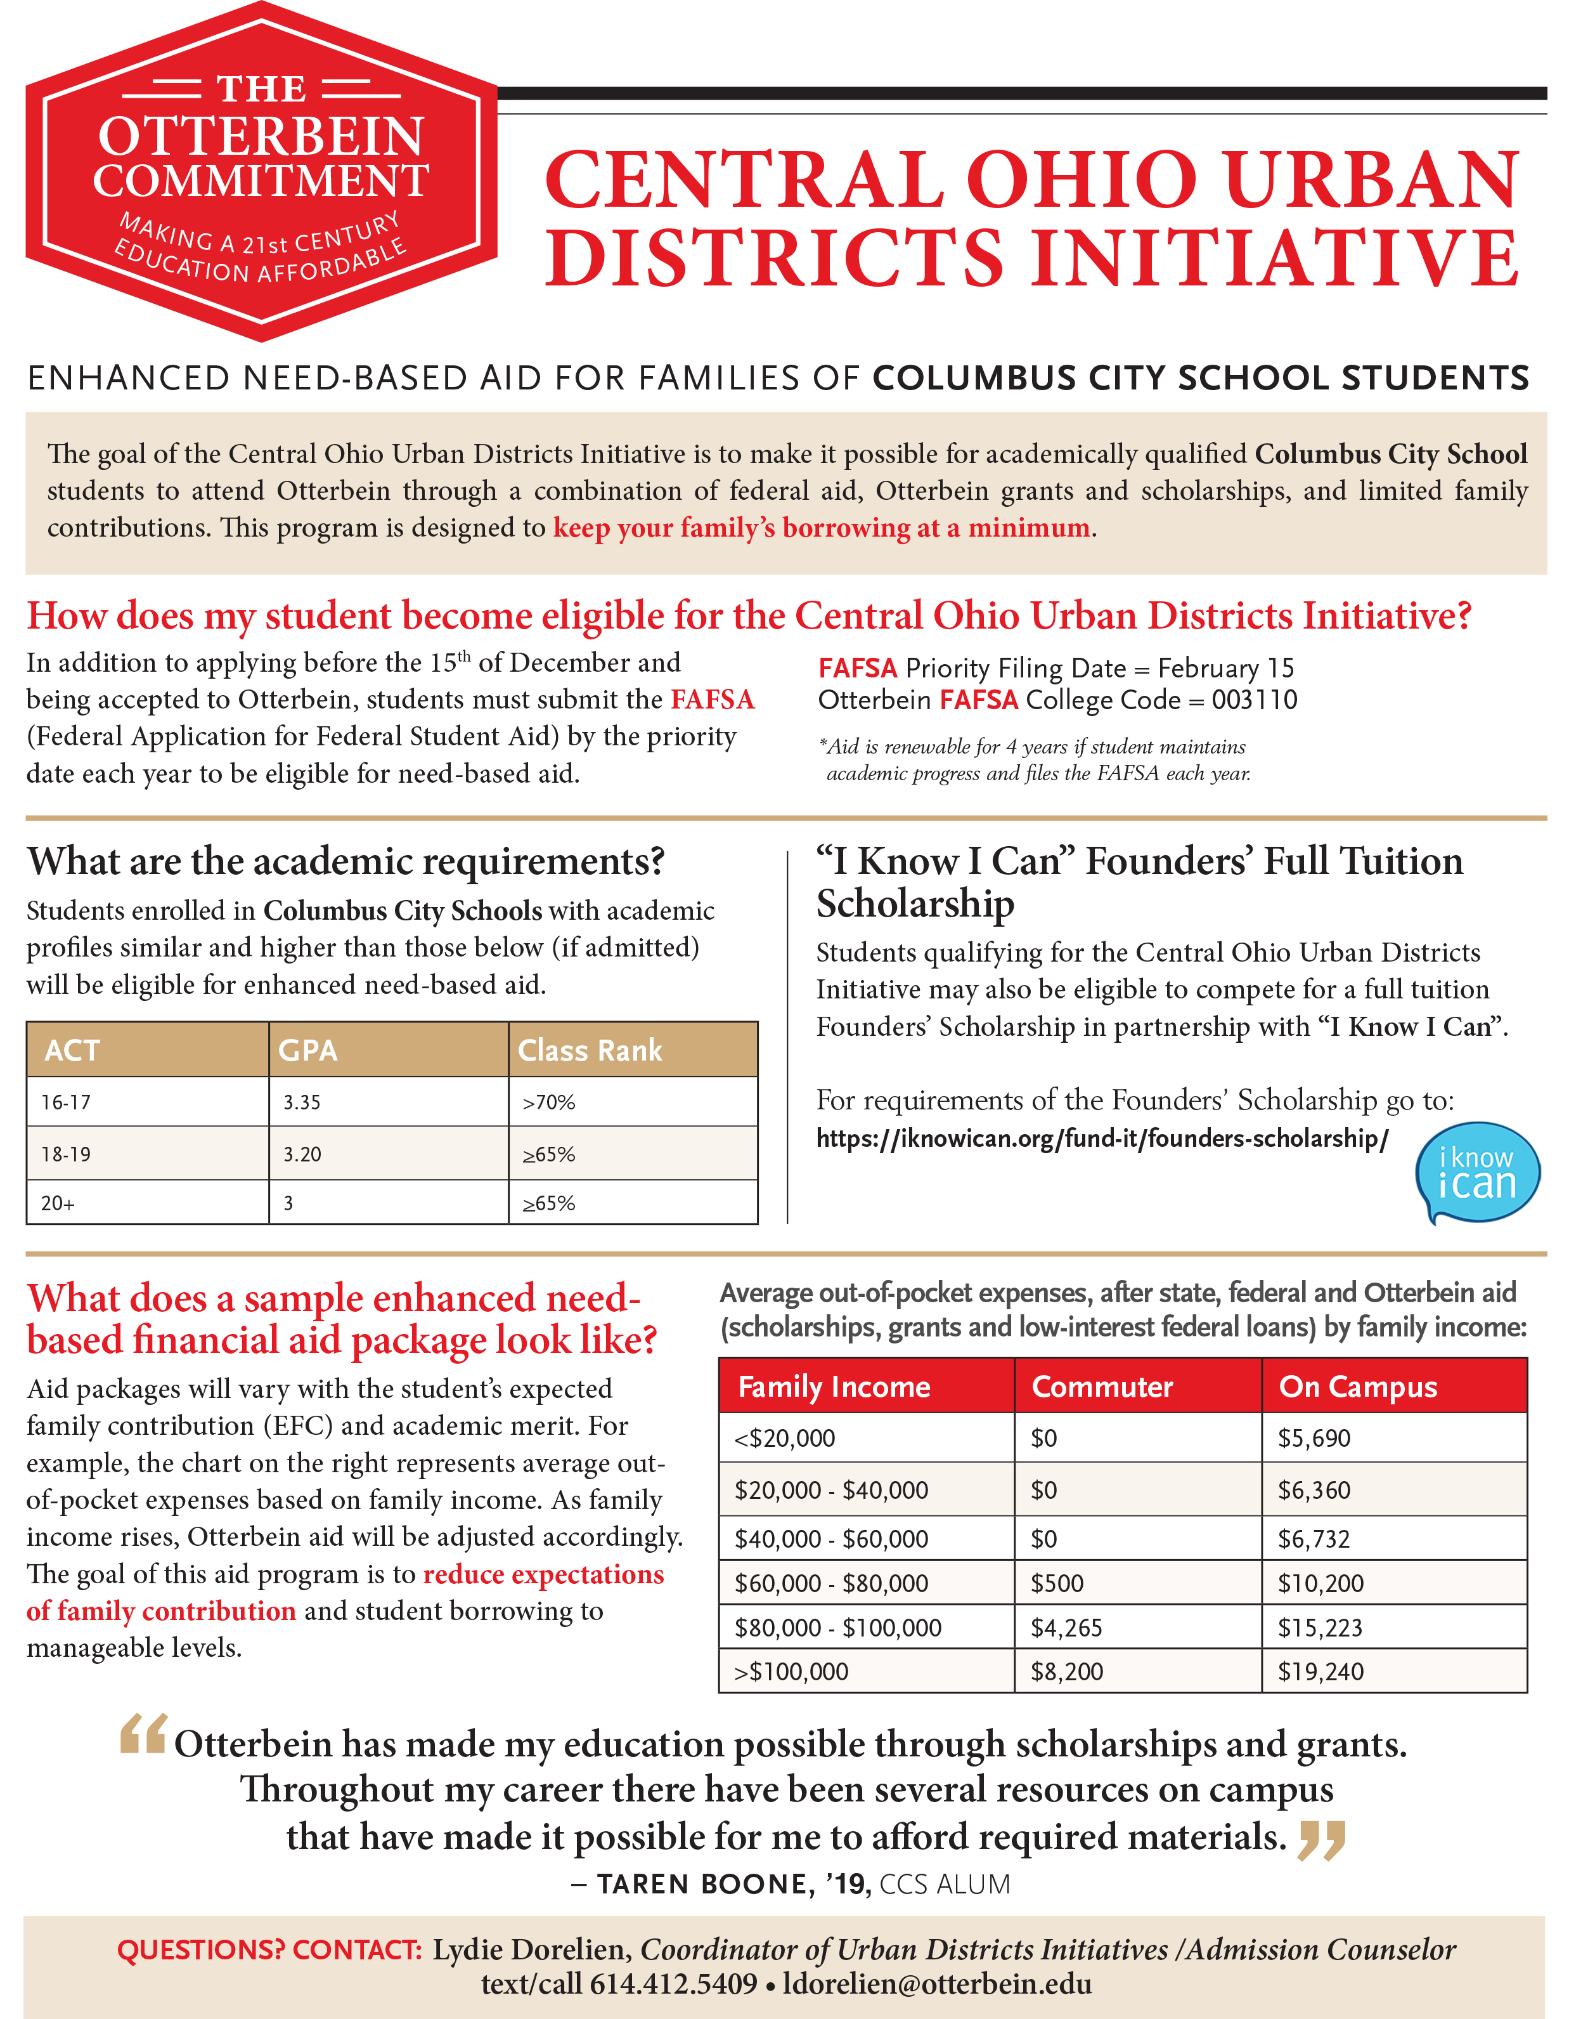
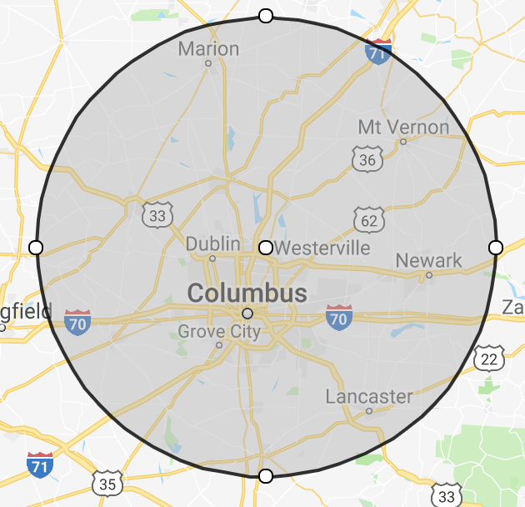

Slide 13
B. Coaches Interviews
Interviewed 13 of 15 varsity head coaches, had email communications with remaining 2.
Learned their best practices, what they did well in recruiting, what they felt could improve and talked about things they felt they need to be successful
GA curriculum, no long applicable because of findings of GA's responsibilities in recruiting. GA Seminar

Slide 14
C. Recruiting Toolbox
Dawn wanted to give the coaches what they need in one centralized location.
Talked with coaches on what they felt they needed.
Brought idea back up in staff meeting, before finalizing tool box.

Slide 15
Coaches Roundtable
Met with entire Athletic Department at quarterly Coaches Roundtable
Discussed best practices as discussed with each coach in our individual meetings
Had the opportunity to bring clarity to some coaches by instructing on official vs non-official visits
Talked about Tool Box and what coaches would like in it
Certain coaches, who excelled in certain aspects of recruiting, were asked to present. Had coaches talk about first visits, incorporating new buildings on campus, campus tours and the transfer portal
Finally had an open discussion where coaches were given the opportunity to talk openly about ideas and best practices presented
Resolved to meet again with Tool Box complete with requests by coaches included.

Slide 16
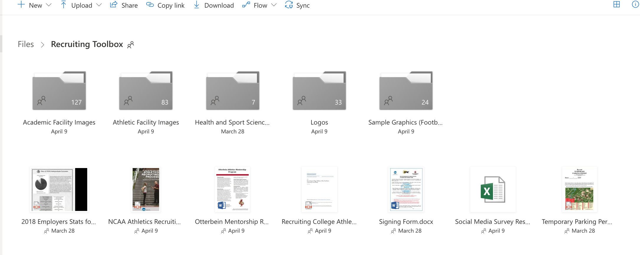
Final Tool Box

Slide 17
GA Seminar
Financial Aid: (20-30 Minutes)
Explain how students are packaged.
Explain timelines of when a package can be expected in accordance to acceptance date, how can we relay this information to parents.
How to use financial aid estimator. Best way to explain to parents and recruits how to use it.
Explain scholarships: what do students gets, how to qualify for scholarships.
How does appeal process work, how to go about it?
Center for Career and Professional Development (Ryan Brechbill): (10-15 Minutes)
Talk about resources Otterbein provides to students to help them be successful after graduation.
President Comerford: (10 Minutes)
What is his vision for the University? What does he think we should be selling about Otterbein?
Where does Athletics fit in with the vision of our University
Mentorship Program (Brandon): (10 Minutes)
Talk about athlete mentorship program and how we can sell this to recruits.
Admissions: (30 Minutes)
Talk about Common App and go over FAQ’s of application process,
What are most common mistakes when applying?
How to answer recruits' questions without referring them to admissions.
Explain baseline GPA/Test scores for admittance. Mock Application?
Explain Otterbein’s most commonly applied majors and how those differ.

Slide 18
GA Sport Specific Handbook
Initially goal was to make a curriculum to prepare GA's for all that would be expected of them in terms of recruiting.
Quickly found out during interviews that every program is so uniquely different. The difference make it so that the head coach assigns their GA's to do very different tasks when it comes to recruiting.
One program did have a system in place in which their past GA's would add to a handbook that was passed down to future Graduate Assistants.
Expressed this idea to coaches at Roundtable as a practice they should adopt. The past GA's know better than anyone what was difficult and what they wish somebody would've taught them their first time around.

Slide 19
What are other universities doing?
Masters' thesis looking exploring recruiting, examined Ohio Northern
Findings
Coaches at ONU found it hard to recruit in season. Don't have the same support staff as bigger schools and are left to recruit in season.
Coaches were down the middle on whether they felt not having scholarships to award made it difficult. Do more seasoned coaches have ways of working around this?
Use their facilities as a selling point, contrary to data showing facilities may not be the biggest factor.
Lack of funding was also a big drawback. Limits what coaches can do when it comes to recruiting.
Geographical location was something coaches felt held them back in recruiting. Ada, Ohio was a tough sell to Student-Athletes.
One Coach went on to say they lost one of the top recruits in their sport to Ohio State due to location

Slide 20
Recruiting
Goals:
Create curriculum to help coaches, especially GA's recruit better
Create knowledge of increasing scholarship opportunities
Explore universities outside of Otterbein.

Slide 21
Mental Health
My Experience

Slide 22
Literature on Mental Health
Research shows that student-athletes need to know where to go to receive help. Once they are aware of their resources, they are more likely to access and see improvement (Van Raalte, 2015).
Almost half of college-aged individuals had a psychiatric disorder in the past year. The overall rate of psychiatric disorders was not different between college-attending individuals and their non–college-attending peers (Blanco et al., 2008)
Study done with Division I S-As showed that up to 23% of S-As exhibit depressive symptoms with nearly 7% exhibiting moderate to severe depressive symptoms (Wolanin et al., 2016)

Slide 23
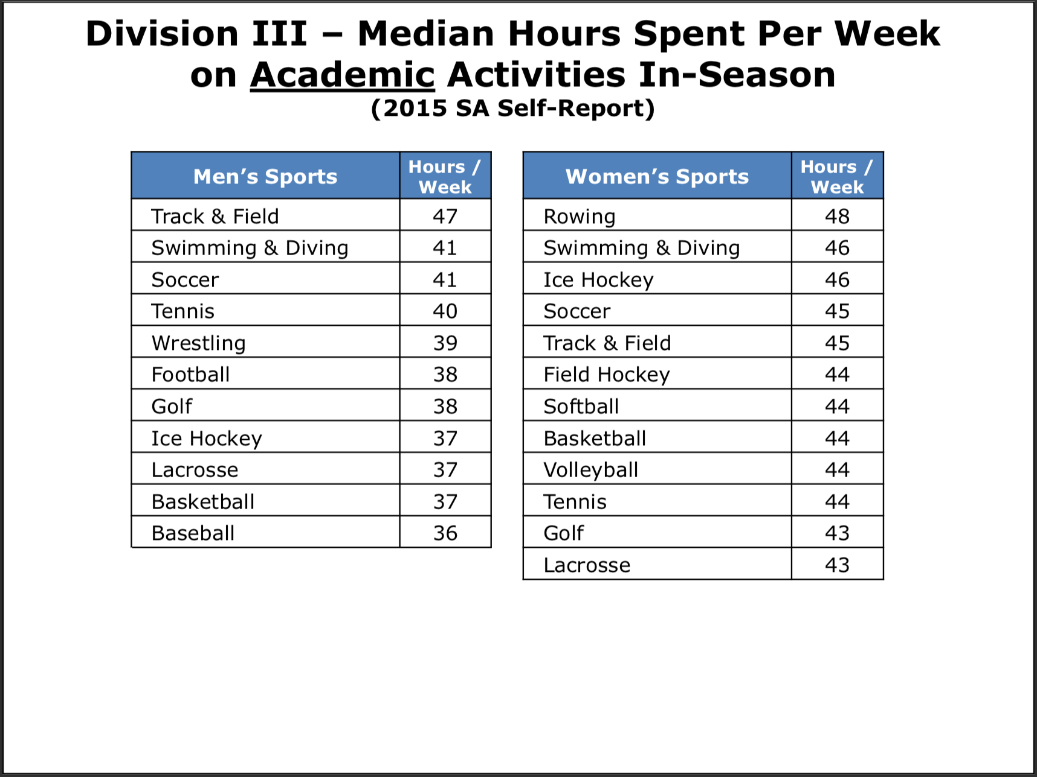
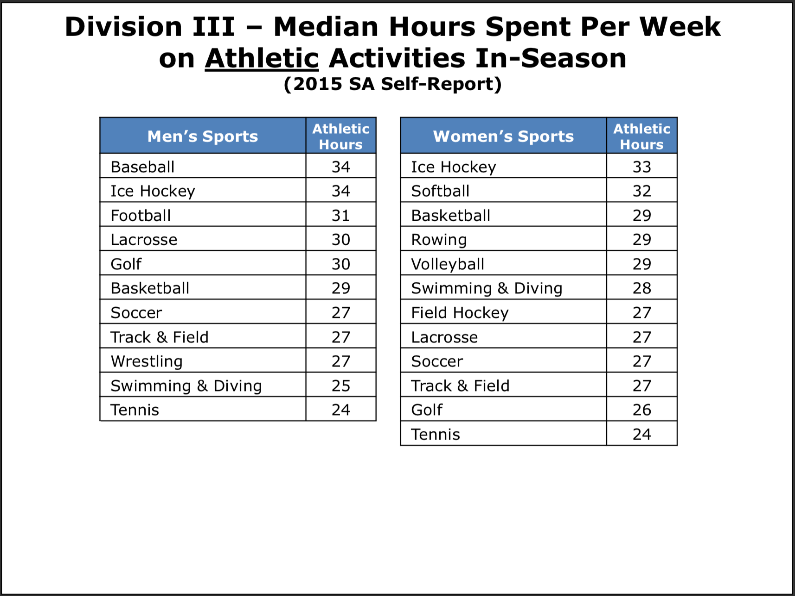
Mental Health
NCAA GOALS

Slide 24
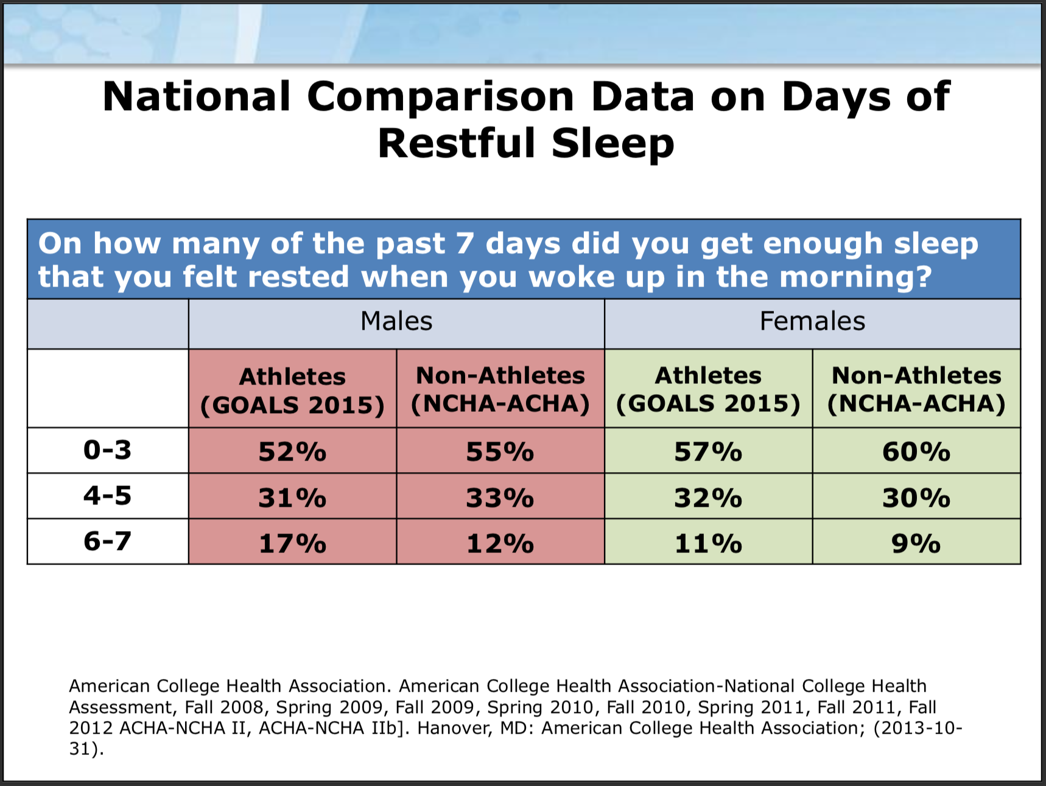
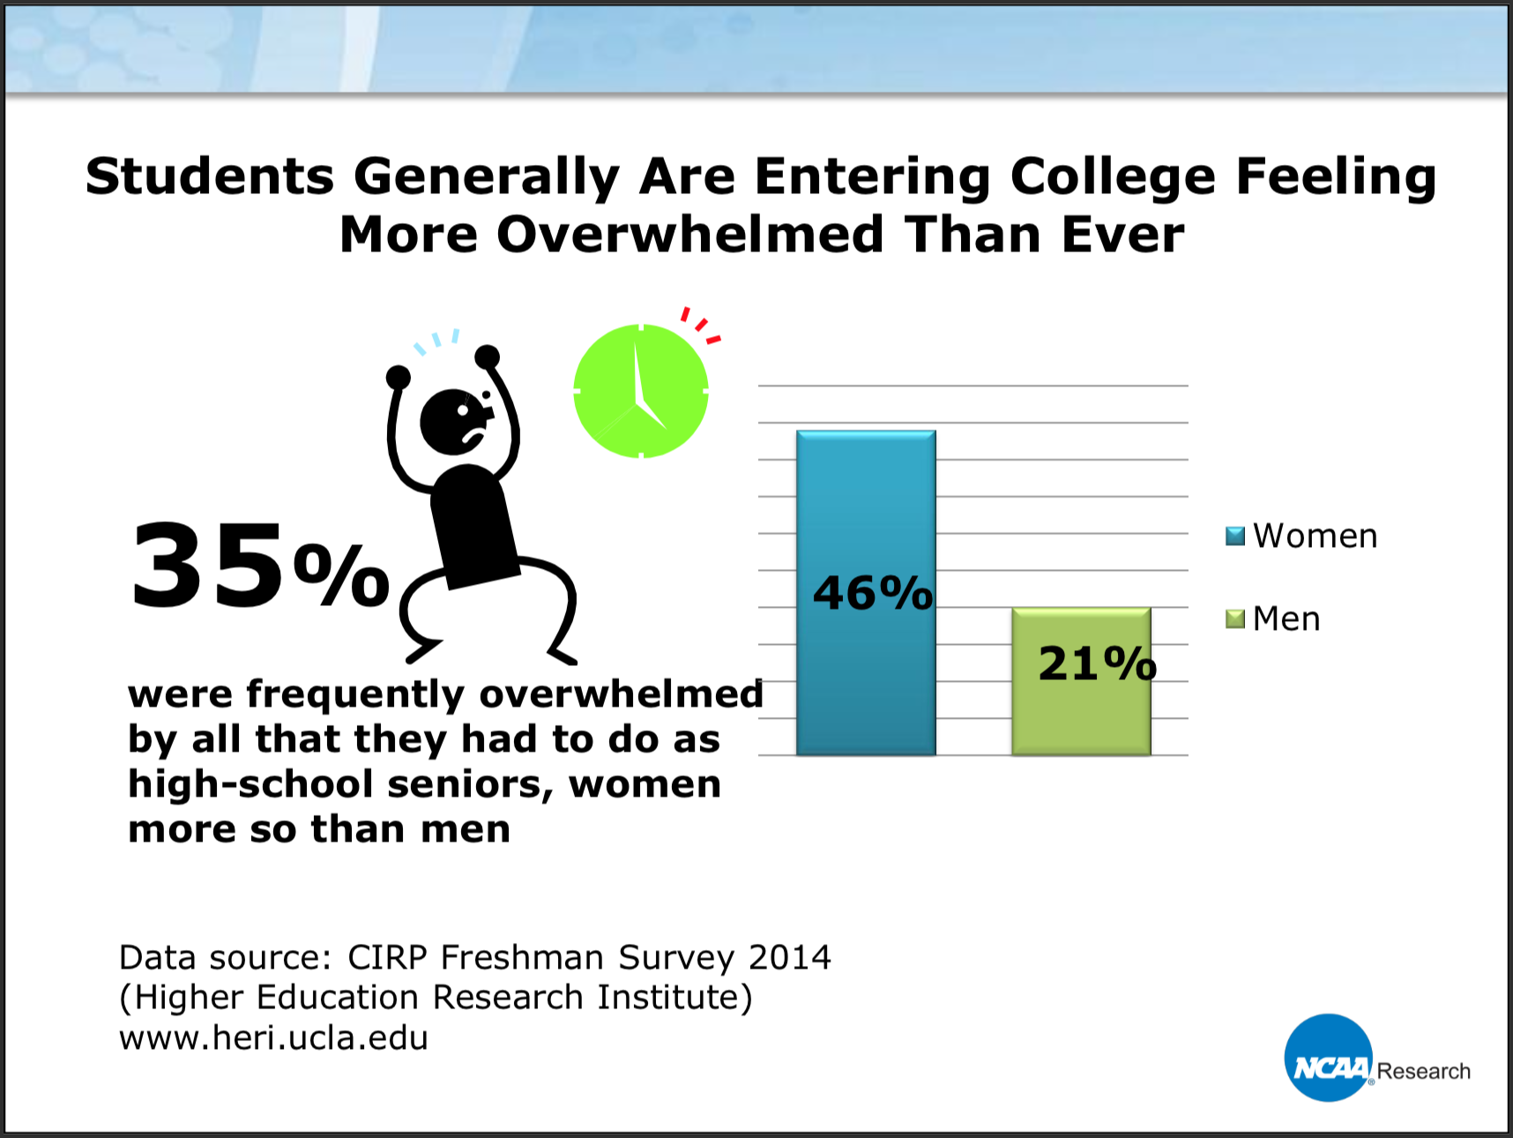
Mental Health
NCAA GOALS

Slide 25
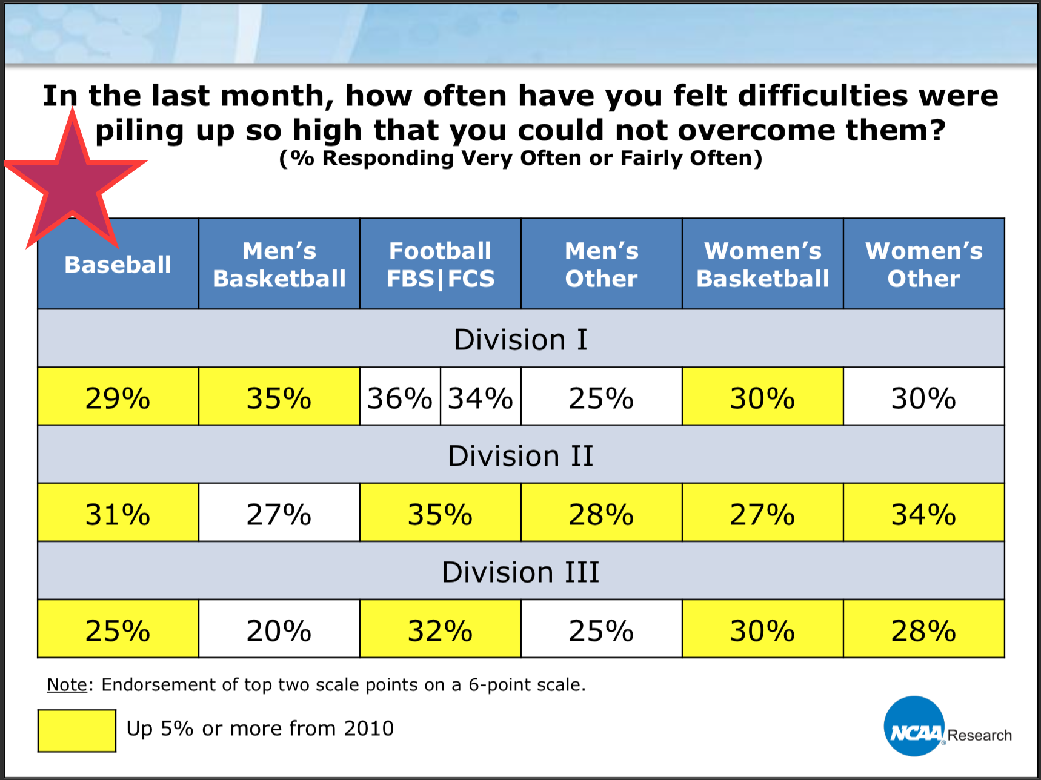
Mental Health
NCAA GOALS

Slide 26
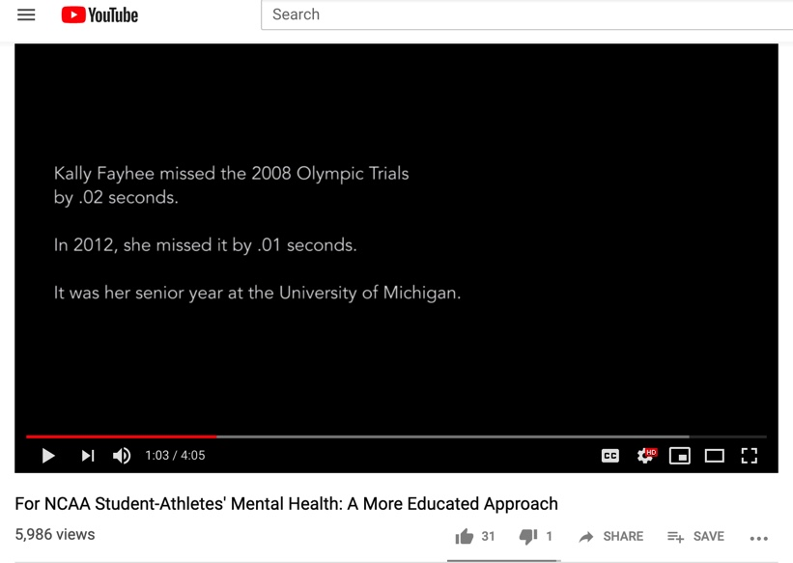
Mental Health
Kally Fayhee Story

Slide 27
Mental Health
Meeting with Julie Saker to discuss what are resources for S-As.
Athletes present unique issue because they will talk to coaches/peers but rarely to other professionals
Counseling Center is a great resource
Best support system is whoever the S-A feel comfortable with
Need campaigns at the beginning of the year to raise awareness for issues.

Slide 28
Mental Health
Meeting with Denise Shively and Students
Desire was to make a video like the NCAA that highlighted athletes struggles with mental health issues.
How do we find S-As willing to tell their stories?
Students in communications class who were working with Active Minds a student run organization on campus focused on decreasing the stigma of mental health issues.
Memo from Dawn asking coaches to be aware of S-As who would be willing to share their story
Did not hear back from any coaches
Unable to complete filming process in time frame
How can we raise awareness?

Slide 29
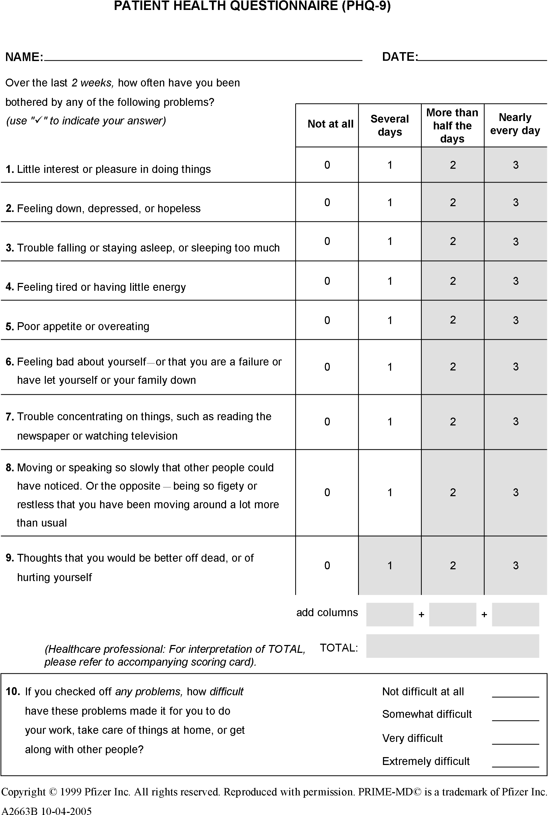
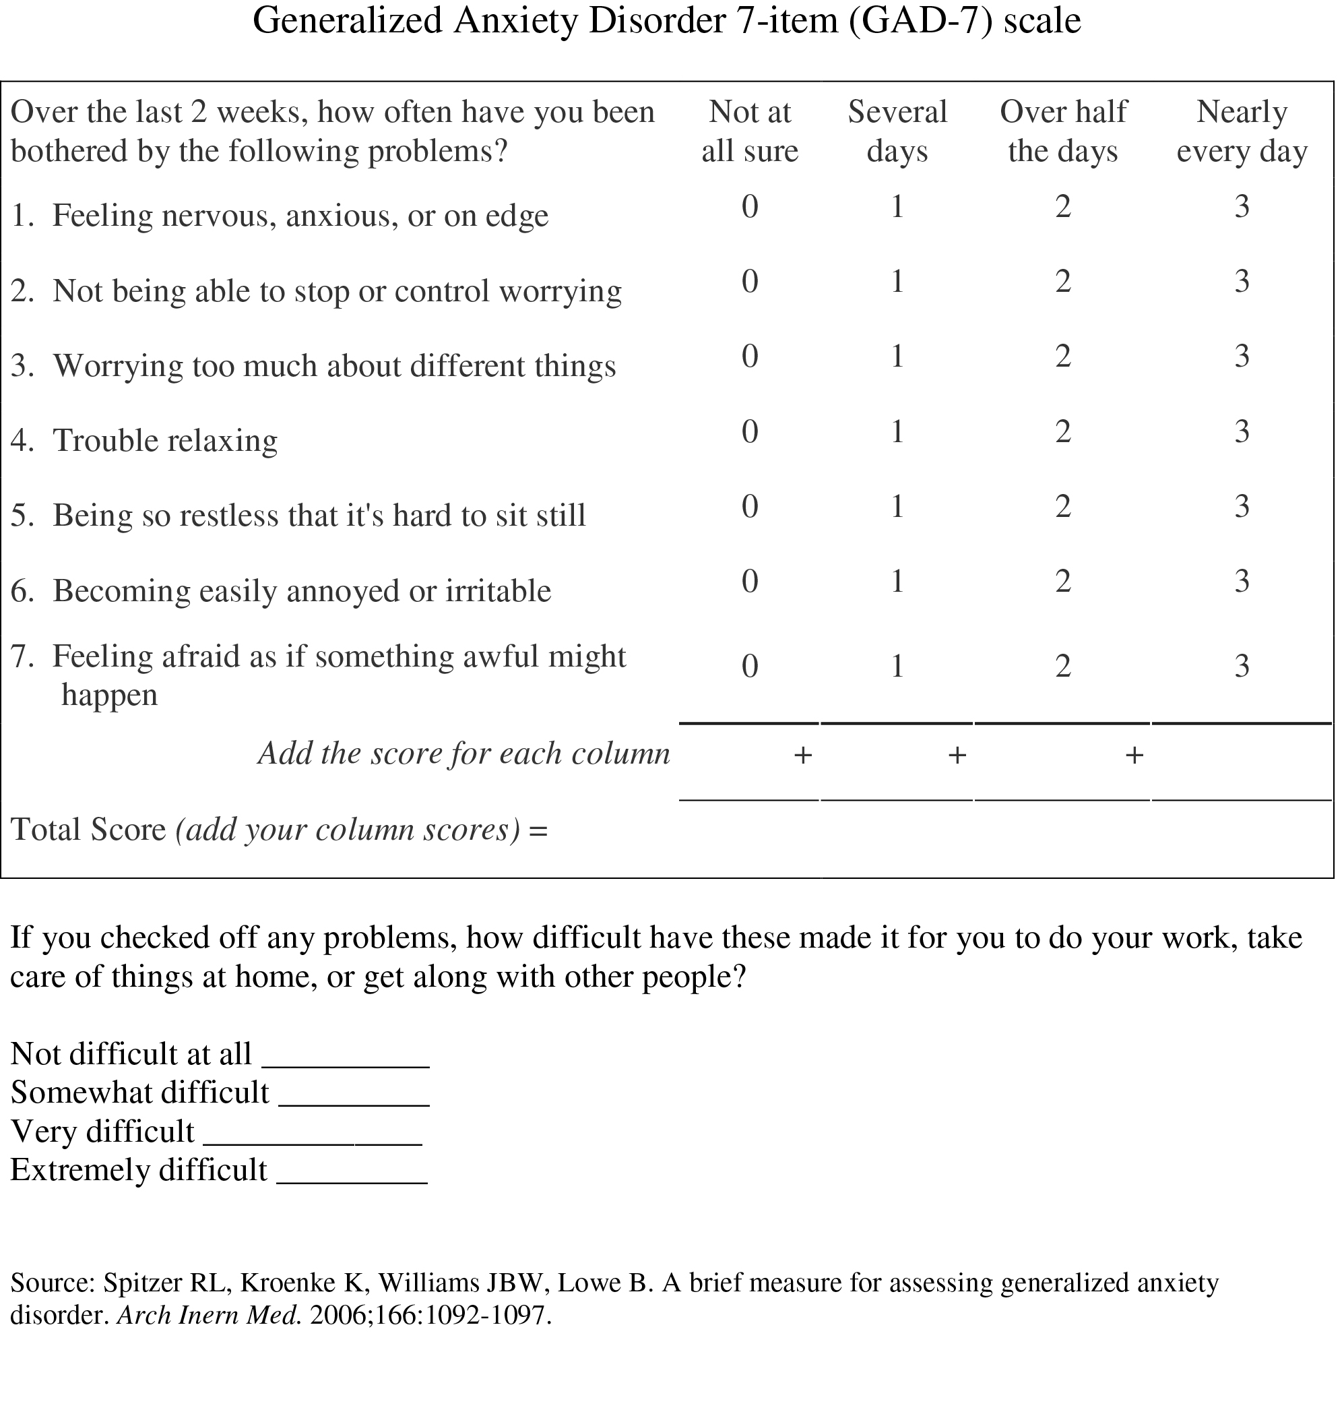
Mental Health
Meeting with Chuck Goodwin head athletic trainer
What is standard protocol for assessing athlete's mental health status upon arrival at Otterbein?
What are we doing for athletes who have shown to be more at risk?
Issues that can be caused because of confidentiality.
Desire of athletic training staff to better assess and treat student-athletes who struggle with their mental health.
GAD-7
PHQ-9

Slide 30
Mental Health
Athletes Connected
Brief, engaging videos to reduce stigma, encourage help-seeking and promote coping skills;
Informational presentations for all coaches and athletes; and
Informal, drop-in support groups offered on a bi-weekly basis, designed to specifically address the unique concerns of student athletes.

Slide 31
Mental Health
Videos
Videos were shown to every U-M coach and athletic team as part of a presentation focusing on:
How to recognize the signs and symptoms of depressive illnesses;
Strategies for prevention, self-care, and help-seeking;
How to support teammates who may be struggling;
Information on the Athletes Connected support groups and other campus mental health resources.
After viewing the videos 99% of athletes responded the material was engaging and relevant to themselves and other S-As.
Will Heininger
96% of S-As reported they were likely to use the information
Athletes Connected

Slide 32
Mental Health
Voluntary Support Groups
92% of student athlete attendees reported that they expect to apply the lessons or coping skills that they learned during the groups
Quotes
“Everyone can have difficulties, and mental illnesses can be similar to physical ailments.”
“I learned that my sport doesn’t define who I am.”
“Just learning to share and talk about things that were upsetting me was a big thing that I took away from the group.”
Athletes Connected

Slide 33
Mental Health
Meeting with Dr. Kathleen Ryan of Otterbein Counseling Center
Work in small groups can be very powerful
Athletes talk with other athletes about their problems
Would love to get Counseling Center involved in Programming for Student-Athletes since very few Student-Athletes frequent the Counseling Center
Fall Programming 2019
6-week program where players come to talk about prediscussed issues
Issues will be decided before hand after deciding what students need.
1 Hr – 1:15 Hr sessions
Topics range from: How to manage stress, Communication with Faculty, recovering from break-ups and how to cope with change.

Slide 34
Mental Health
Conversation with Emily Klueh: Program Director of Athletes Connected
Meet with SAAC to be able hear from student-athletes what issues are pressing on Otterbein Campus.
Help with perception/stigma by helping student-athletes understand they won't be viewed as weak or lose playing time by talking about their mental health.
Lime Green bandana's or wristbands to raise awareness for Mental Health

Slide 35
Mental Health
NCAA Monthly Webinar on Mental Health

Slide 36
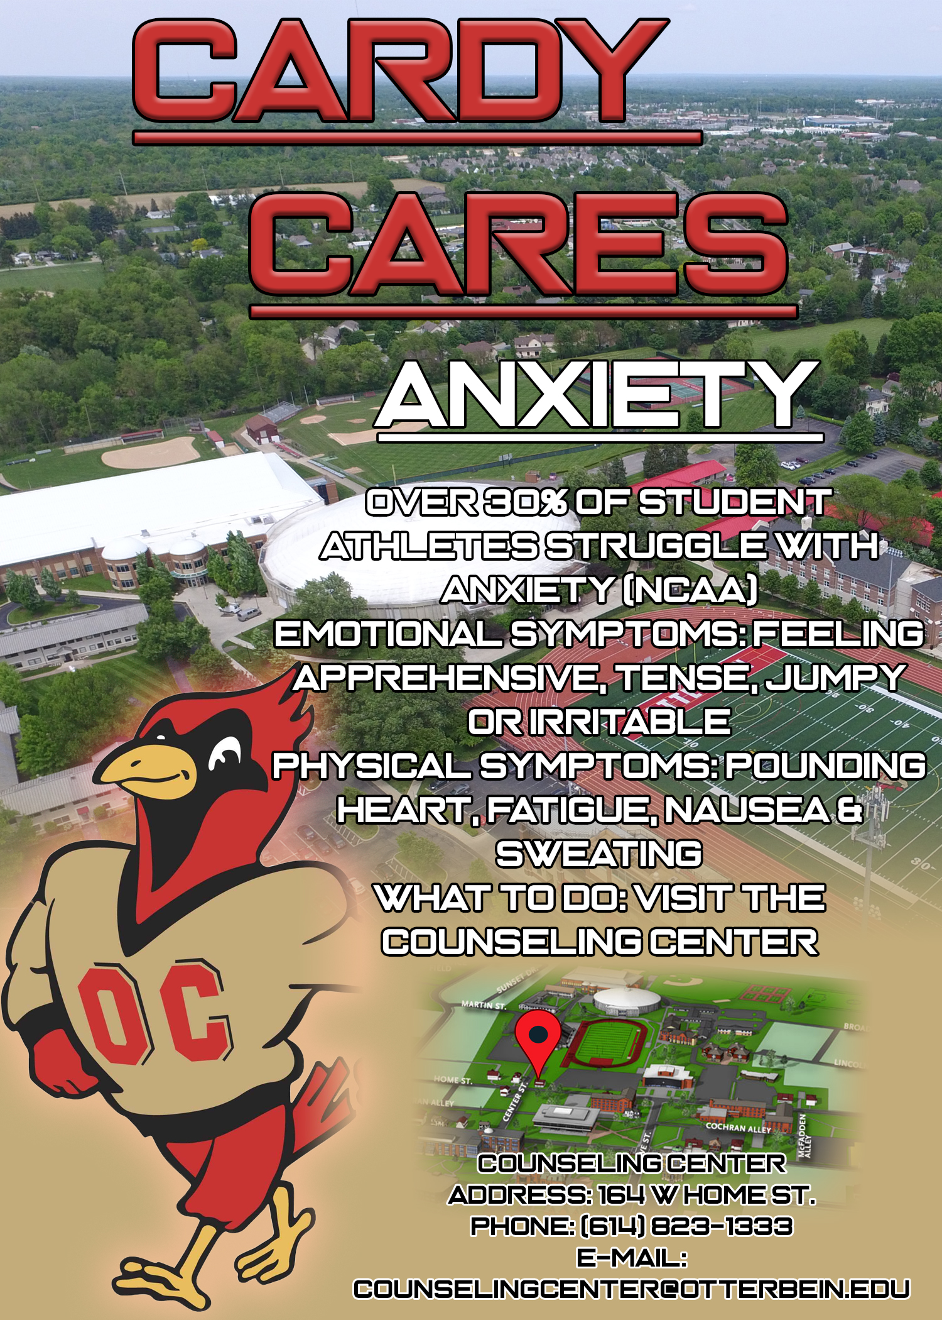
Mental Health
Going Forward
Raise awareness for Counseling Center by having introductory meeting with Dr Ryan and S-A's at beginning of Academice year.
Change way we evaluate players through NCAA recommended evaluations
Small Group Programming
Get involved with Active Minds to help break the stigma of
Mental Health
Awareness campaign through bandanas and wristbands
Incorporate SAAC and FAR representatives to help incorporate ideas.
Cardy Cares Campaign
Evaluate reporting procedures
Evaluate Emergency protocols for coaches
Informational meetings with Athletic Staff

Slide 37
What I Learned
Recruiting
Every program recruits differently, GA's need seminar and not necessarily a curriculum to better prepare them.
Always will have challenges due to funding, how does your program make up for it.
Research shows recruits appreciate location and personal relationships over facilities.
Mental Health
Awareness is key: S-As must know where Counseling Center and other resources are.
Coaches must understand signs of players struggling with mental health and know what to do.
Students know what students need, involve student-athletes in the planning of programming.

Slide 38
Questions?

Slide 39
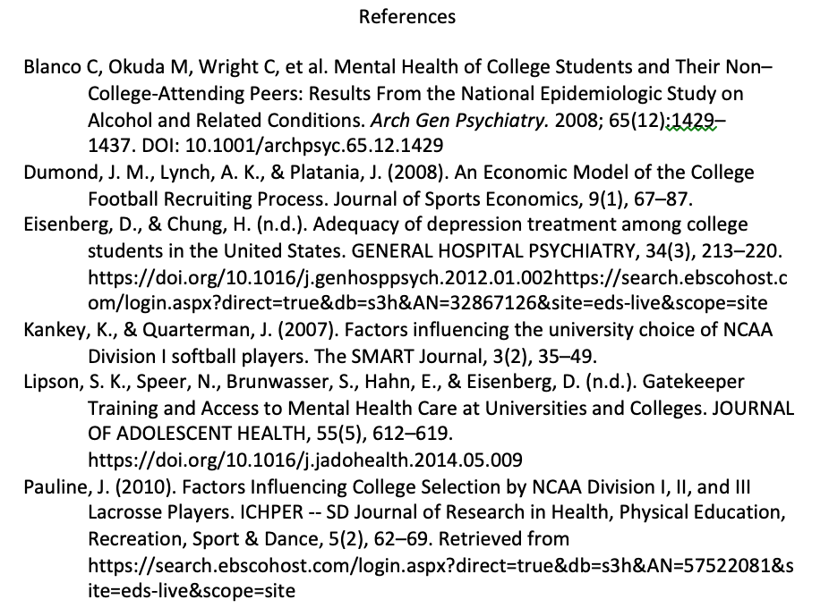
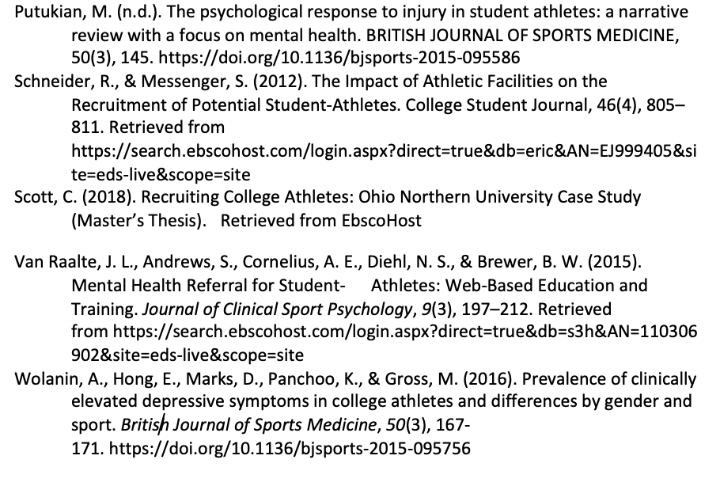
References

