Slide 1
Reflections on Healthcare Administration Practicum - My Journey with
OhioHealth Doctors Hospital
Anitha Guduri

Slide 2
Agenda
Practicum background
Goals
Projects
Tasks and challenges
Learning outcomes and benefits
Suggestions
Discussion and questions

Slide 3
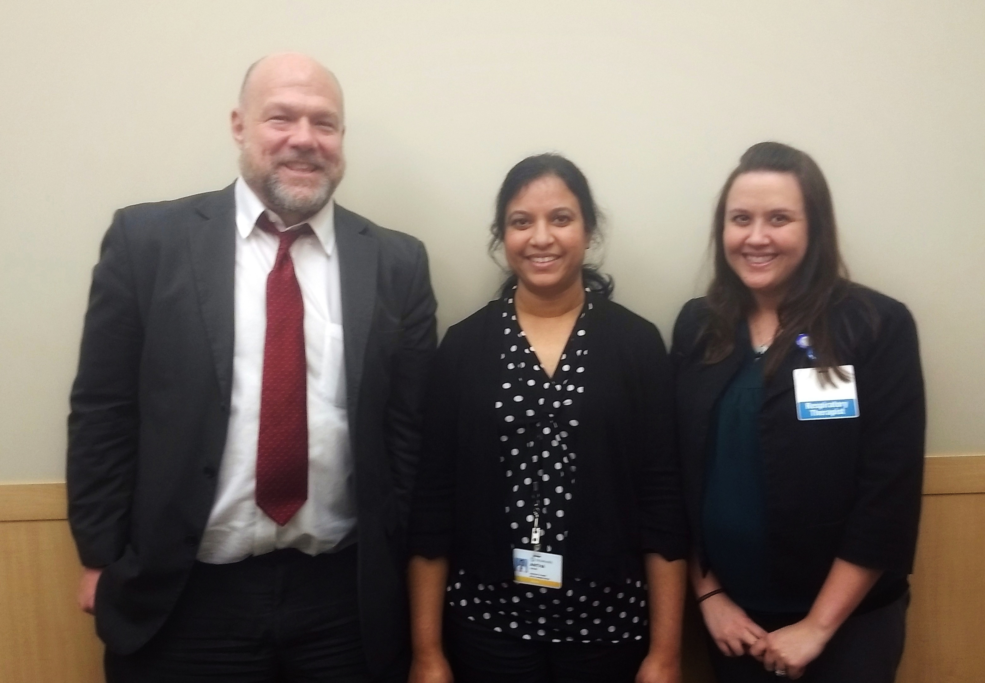
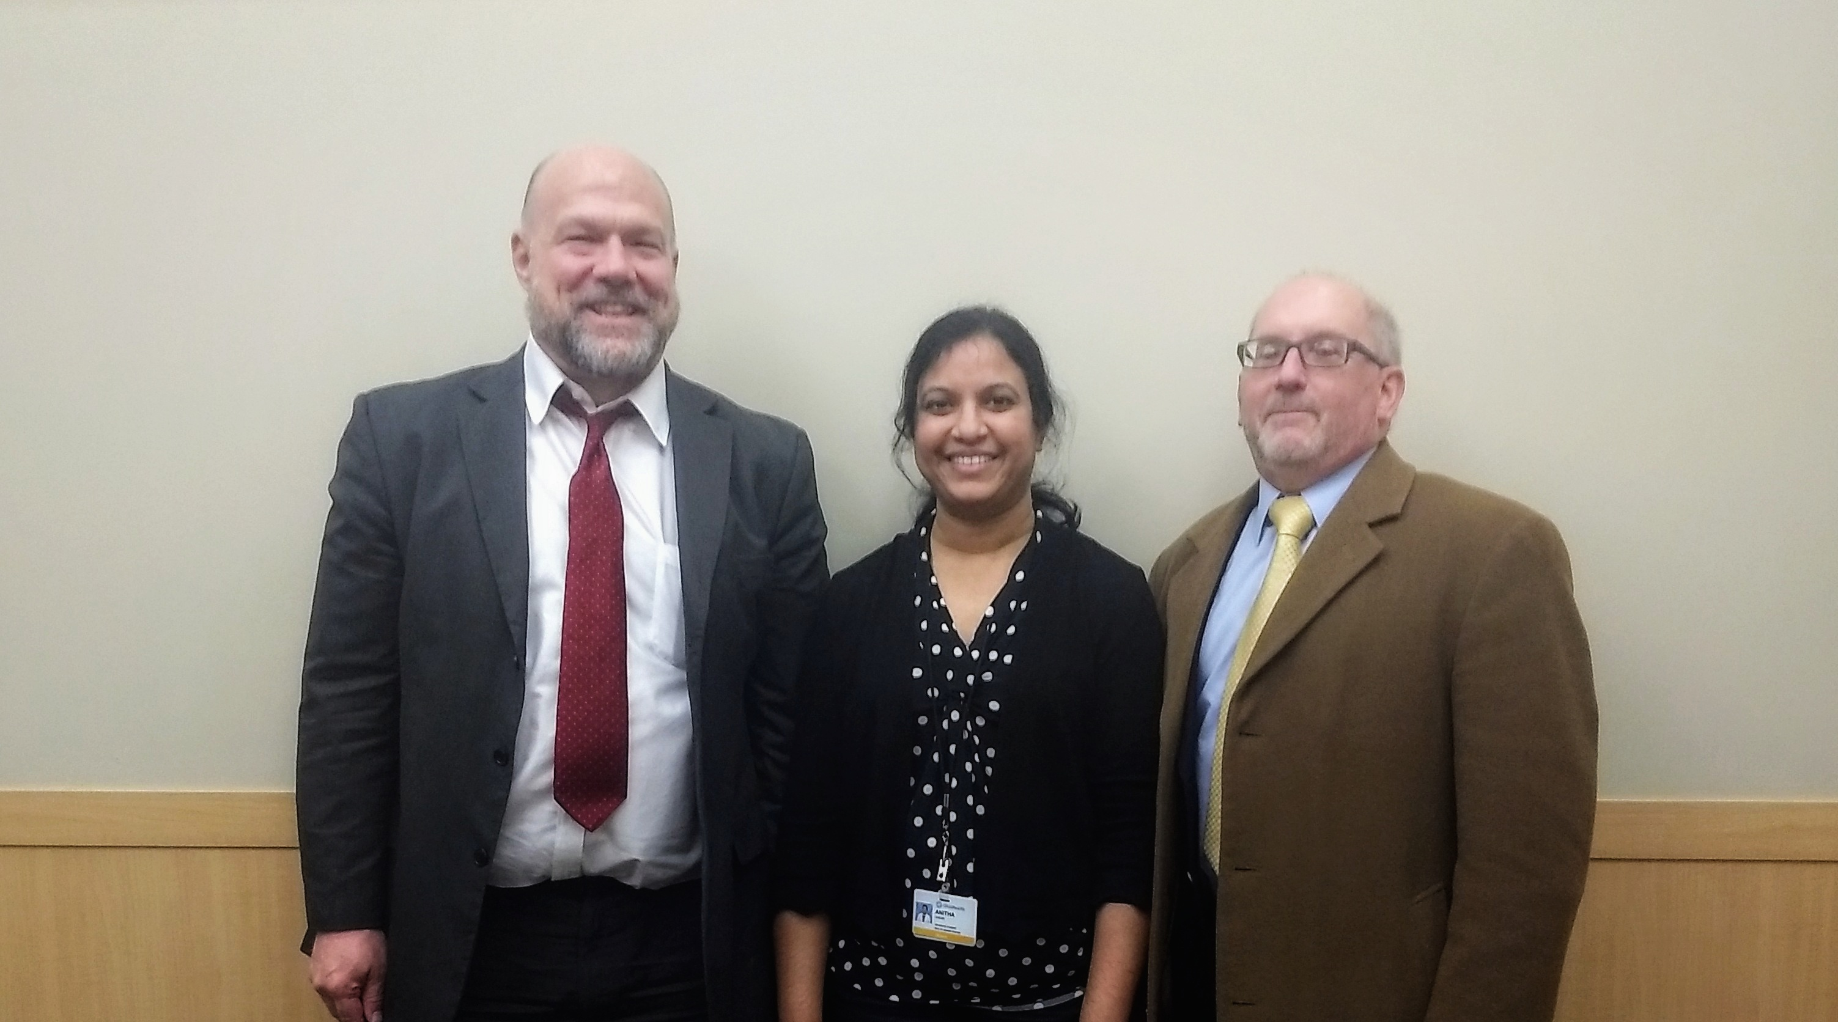
Background Information
OhioHealth Doctors Hospital
Site Supervisors:
Dr. Joseph Geskey, D.O., MBA
Vice President, Medical Affairs.
Kimberly Hehman, MS RRT RCP CTTS
Director of Pulmonary and Cancer Services.
Practicum Advisor:
Dr. Paul Longenecker, RN, MBA, PhD
Program Director, Master of Science in Allied Health, Otterbein University.

Slide 4
Credentials of Site Supervisors
Dr. Joseph Geskey
An experienced physician with a demonstrated history of working in the hospital & health care industry.
Skilled in Population Health, Electronic Medical Record (EMR), Clinical Research, Medical Affairs, Peer Review, Clinical Leadership, Chronic Disease Management & Health Literacy.
Kim Hehman
A Respiratory therapist by background plus has Master of Science Degree in Allied Health Management.
Community outreach – prevention of oncologic diseases.
Tobacco treatment specialist.

Slide 5
Practicum Goals
Gain administrative work experience
Gain hands-on experience in relation to teamwork and collaboration
Develop interpersonal communication skills
Expand oral and written communication skills
Work effectively within diverse environments
Gain confidence to establish in a career

Slide 6
Practicum Outline
Primary Project
Social Determinants of Health Pilot study
Secondary Projects
Bundled Payment Care Initiatives (BPCI) – COPD and GI Hemorrhage
Main focus on COPD – Noninvasive (NIV) care
Researching evidence-based information in support of Bundles
Tertiary experience
Accreditation meetings
Gemba walks
Tumor board meetings

Slide 7
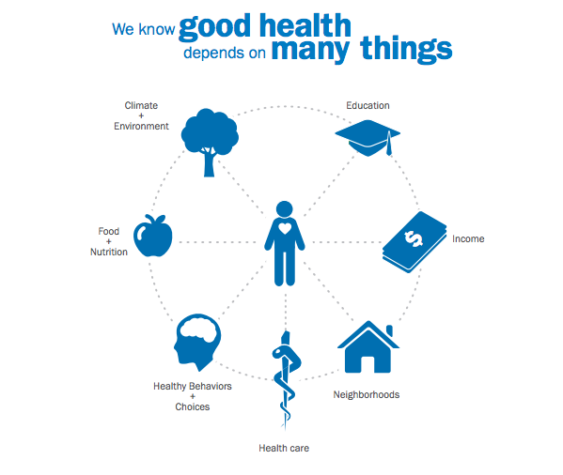
Practicum Outline
Primary Project:
Social Determinants of Health Pilot study
An 18-month long study.
Focus on 3 main domains - food, housing and transportation.
Purpose is to anticipate the needs of high utilizer Emergency Department (ED) patients.
Build a community partnership to ease burden.
Goal to reduce readmissions and unnecessary visits to the ED.
Notes:
SDOH are the conditions in the environments in which people are born, live, work, play ,worship and age that effect a wide range of the health, functioning and quality of life outcomes & risks.
Franklinton: Education - 39% and Unemployment –20%
New Albany: Education – 98% and Unemployment - 3%

Slide 8
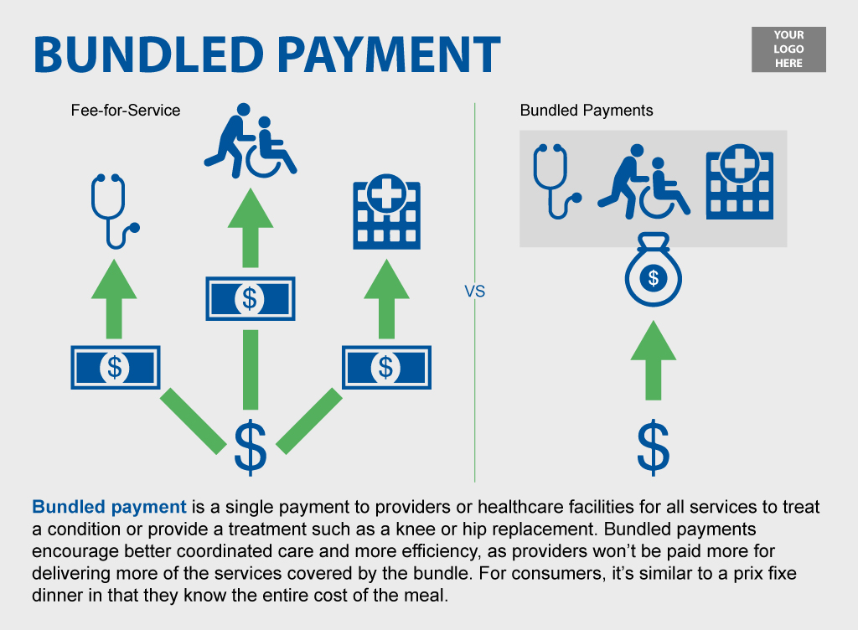
Practicum Outline
Secondary Project:
BPCI - COPD & GI Hemorrhage
Developed by the Center for Medicare and Medicaid Innovation (Innovation Center).
Organizations enter into payment arrangements with Centers for Medicare and Medicaid services (CMS).
Financial and performance accountability for episodes of care.
Notes:
Bundled payments – Also known as episode based /episode of care payment. These are reimbursement of health care providers on the basis of expected costs for clinically defined episode of care. Middle ground between fee for service and capitation. (LUMPOSUM per patient regardless of how many services the patient receives – so the risk is shared between payer and provider.
STRATEGY _ for reducing healthcare costs. About 1/3 of US health reimbursements uses this methodology.
My work was more focused on NIV especially Post discharge –integrating home health in patient care and standardizing the work flow across the care sites for continuum of care.

Slide 9
Practicum Outline
Tertiary:
Gemba Walks
Lean management philosophy
Observe the actual work process
Engage with employees
Gain knowledge about the work process and
Explore opportunities for continuous improvement (Kanbanize, 2019)

Slide 10
Tasks Assigned
Assisting in strategic planning and implementation of the project.
Attend meetings related to the projects.
Create meeting agendas and talking points.
Creating PowerPoint Presentations and Request for proposal.
Notes:
A request for proposal (RFP) is a document that solicits proposal, often made through a bidding process, by an agency or company interested in procurement of a commodity, service, or valuable asset, to potential suppliers to submit business proposals.

Slide 11
Tasks Assigned
Drafting emails to stakeholders.
Researching topics related to the projects assigned.
Creating excel sheets relating to goals.
Conducting Tabletop exercise/drill of the Pilot study.
Notes:
A tabletop exercise (TTX) is a simulation activity that takes participants through the actual intended process. It not only helps participants familiarize themselves with the response process, but enables administrators to gauge the effectiveness of the organization's emergency response practices.

Slide 12
Learning Outcomes
Feel free to ask questions if you do not know.
Make notes and organize your work.
Learn by observing more than talking.
Build trust, work hard to show your best.
Real world is different from classroom.
Always consider other's perspectives.
Be professional, simple, courteous and creative.
Be kind and respectful no matter which position you hold.

Slide 13
Challenges
Facing the real workplace scenario
Feeling shy/timid
Hesitancy to speak out
Slow in pace
Computer skills - working on excel
Writing skills

Slide 14
Benefits
Exposure to an organization's structure and culture
Practical and managerial skills
Develop confidence
Self-responsibility
Organizing work
Punctuality
Networking skills
Patience and humility

Slide 15
Lessons Learned
With respect to Leadership:
Flexibility, adaptability and commitment
Governance and management, which include
creating a vision
empowering others
fostering collaboration and
guiding decision making
Apply negotiation and mediation skills
address organizational or community challenges

Slide 16
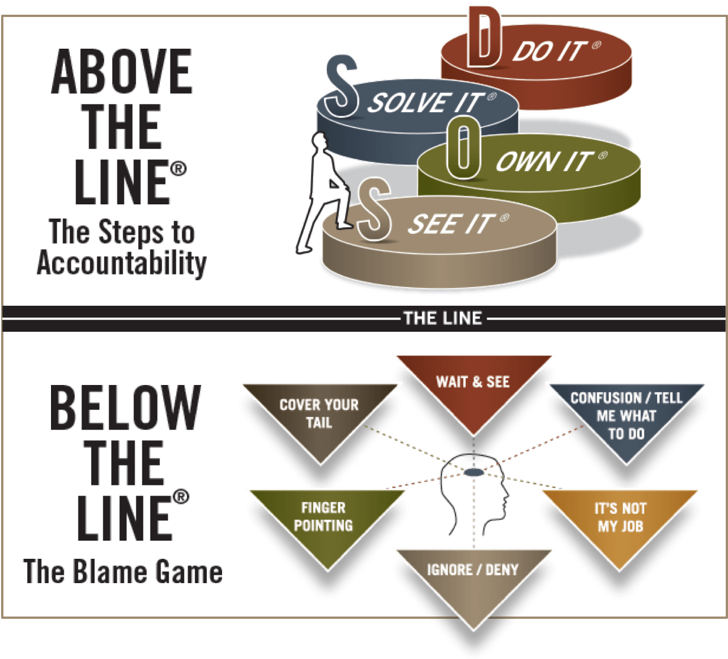
Pivotal Moment
Leadership's:
Above the line behavior
Adaptability to change management
Ability to lead by example
Advise and assure the team

Slide 17
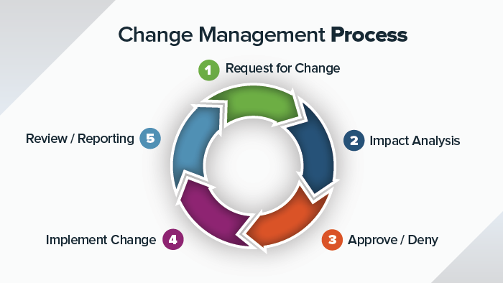
Conscious Leadership

Slide 18
Suggestions
For the program
Maintain a steady supply of qualified students
Continue internship relationship
For the host organization
Provide the opportunity
Giving access for learning purposes
For the future interns
Choose "real world" project experience
Multidisciplinary teamwork experience that is so important in healthcare
Learn by observation

Slide 19
Discussion & Questions

Slide 20
THANK YOU

Slide 21
References
ATL-BTL Chart [Digital image]. (2018). Retrieved April 7, 2019, from https://theceomonk.com/atl-btl-chart/
Hollenberger, L. (2016). Care Coordination at Copley Hospital [Digital image]. Retrieved April 4, 2019, from https://www.livewelllamoille.com/care-coordination-at-copley-hospital/
Kanbanize. (2019). Gemba Walk: Where the Real Work Happens. Retrieved April 4, 2019, from https://kanbanize.com/lean-management/improvement/gemba-walk/
Kanbanize. (2019). Gemba Walk: Where the Real Work Happens [Digital image]. Retrieved April 4, 2019, from https://kanbanize.com/lean-management/improvement/gemba-walk/
Smartsheet. (2019). 8 Elements of an Effective Change Management Process [Digital image]. Retrieved April 4, 2019, from https://www.smartsheet.com/8-elements-effective-change-management-process
Wang, R., & Navathe, A. (n.d.). Innovation in Health Care Delivery: Bundled Payments for High-Value Care [Digital image]. Retrieved April 4, 2019, from https://ldi.upenn.edu/sites/default/files/sumr_docs/WangRobin_InnovationinHealthCareDelivery.pdf

