Slide 1
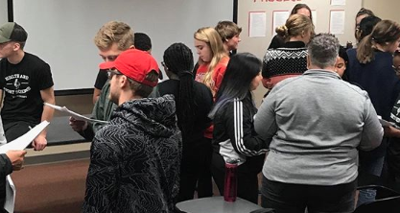
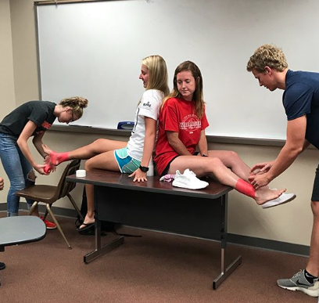
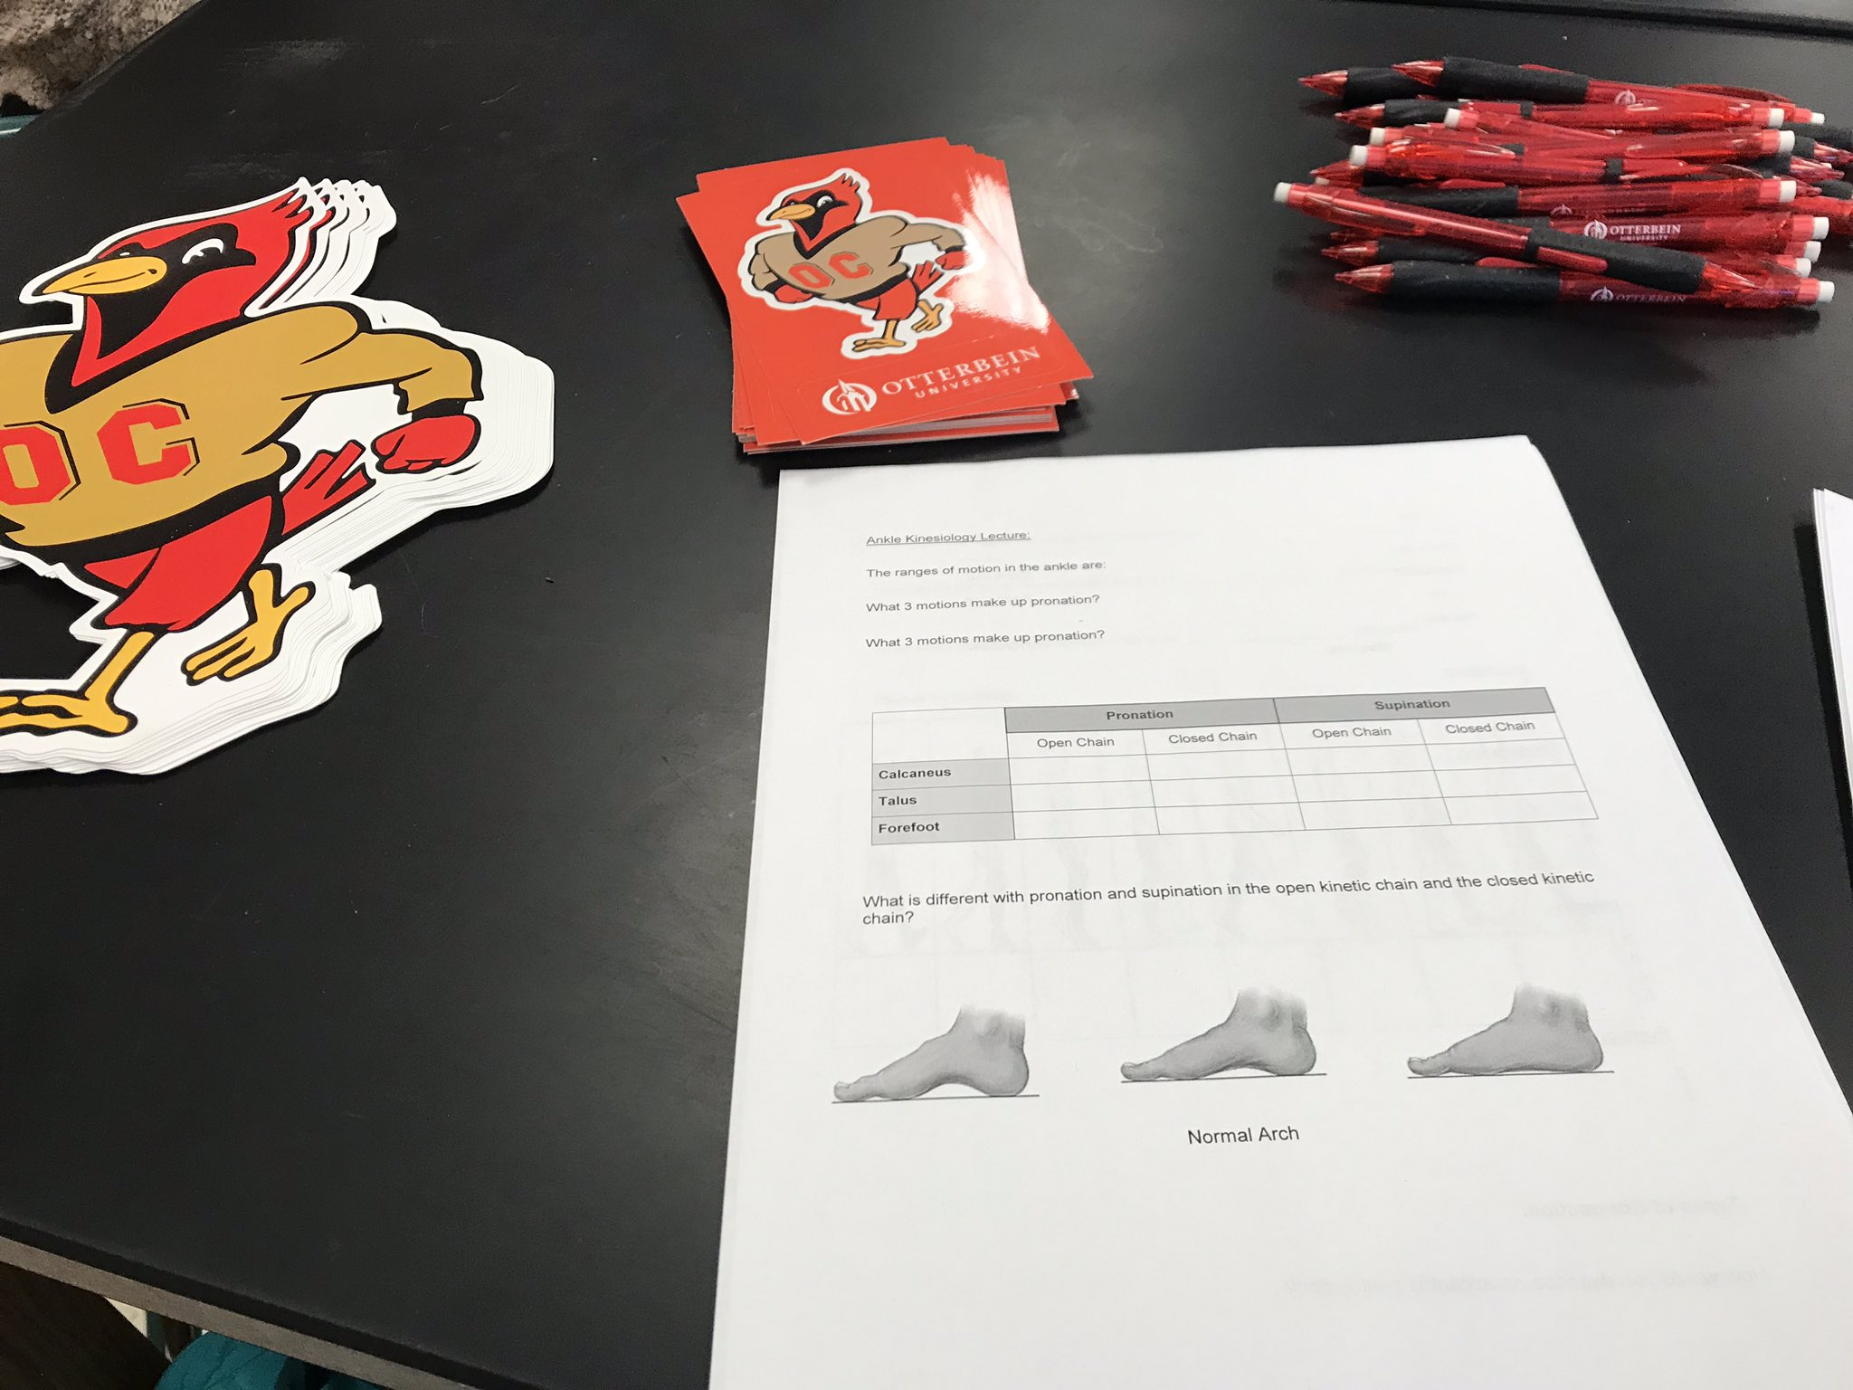
Allied Heath Education: Teaching Assistant at Otterbein University and High School Outreach Programs
Andrea Pohlman ATC
Abstract
Teaching Assistant
High School Outreach
Outcome
My practicum was created to provide me with the opportunity of learning how to teach in the Allied Health Education field. There was two main parts of my practicum. The first part was being a teaching assistant in the freshmen Introduction into Allied Healthcare Professions course and the junior level Therapeutic Interventions course. The second part was assisting in the creation of a two day high school outreach program.
The main goal of this practicum was to prepare myself with the skills to become a clinician, preceptor, and educator in the field of Athletic Training.
The high school outreach program was a two day session. The first day was going into their high school and completing a lecture about ankle kinesiology. The second day, the students came onto Otterbein’s campus and use the facilities.
Lesson Plan:
I created the lesson plan for the lecture day. This included course objective and a lesson outline. The goal of this was to create a lesson that would set the students up for the lab session.
Lecture:
This lecture covered the basics of ankle kinesiology. This lecture explained: boney anatomy, muscles and their functions, range of motion, open kinetic chain and closed kinetic chain, foot type, and the gait pattern. There were interactive portions where the students would hands on experience the ranges of motion and they learned how to manual muscle test the muscles of the lower leg.
For the students to follow along and take notes, I created a handout outlining the key points. The outline had fill in the blank portions.
Lab day:
Students came to campus and had a brief lecture recapping the previous day, and outlining the lab portion.
The students then separated and rotated through three stations. The stations were, using the Biomechanics running lab for an analysis, completing the Y-Balance Test, and completing the Landing Error Scoring System Test. The students were able to learn how filming and reviewing the test can help identify athletes who are at risk for injuries. They also discovered how filming can help with cueing athletes to proper running and landing form.
From this practicum I developed the knowledge of what goes into making a successful lesson plan, lecture, and lab. I discovered how to make a lesson plan, informative for the students while also being fun and interactive to keep their attention.
I learned the importance of having a handout for any lab day. It helps give the students a structured schedule and keep them focused on the outcomes of the planned lab.
When creating a session plan, I realized the importance of using Bloom’s taxonomy in creating learning objectives. This helped plan and execute the lessons and labs.
When planning public speakers, I learned how important it is to have the students create questions ahead of time. It helped facilitate conversation and allow for full use of the knowledge the speaker can share.
I also learned how to explain concepts to different levels of students. I worked with high school students, college freshmen, and college juniors. How you explain topics vary depending on their level. With high school students, you need to explain topics in a more generalized way. College freshmen need to be taught in more in-depth manner where you explain what and why you are trying to teach them that. College juniors are different because while you are teaching them the what and why, you need to be showing them the real life application of what they are learning.
ATHT 1000:
Guest Speakers:
One of my first roles was to contact and arrange guest speakers. The first half of the semester, I brought in speakers from various centers on campus. Examples of these were the Center for Student Success, Center for Career and Professional Development, and Academic Support Center. The second half of the semester included guest speakers from various health care professions. These were all Otterbein alumni that are now physical therapists, athletic trainers, or physician assistants. Prior to each guest speaker, the students would turn in an index card of two questions. Once the speaker was done with their presentation, I would facilitate a question and answer session.
Lecture:
This class was an introduction to different aspects of allied health. I presented the portion on therapeutic exercise.
Lab Days:
I created multiple lab days with the class. One day was a multi-station class where students learned ankle taping, balance testing, and crutch fitting. Following there was a competition to show what they learned. Additionally, I created a therapeutic exercise lab where students got to practice different strengthening techniques. I also taught the students about therapeutic modalities such as ice, paraffin bath, heat, and ultrasound.
I also developed and explained the therapeutic exercise lab and part of the therapeutic modalities lab.
Office Hours:
Once a week, I held office hours. Students had the opportunity to ask questions and get assistance with assignments.
E-Portfolio:
I helped students create and format their E-Portfolios with the Allied Health template. I also showed them how to upload assignments, edit pages, and upload it to the professor at the end of the year.
ATHT 4700:
In addition to assisting on lab days and lectures, I held office hours where I would assist students with assignments and studying.
Goals
My goals for being a teaching assistant included the following:
ATHT 1000:
To develop the lecture regarding therapeutic exercise or modalities and present it to the ATHT 1000 class.
To organize the majority of guest speakers and help facilitate conversation with the guest speaker and the class.
To be involved in the planning and presenting of all lab days.
To develop and perform office hours to assist the students in a one on one environment.
To help the students create and use E-portfolio.
ATHT 4700:
To be a resource for students in the 4700 class all semester.
To aid in the instruction and lab days of the rehabilitation portion of the 4700 class.
My goals for the high school outreach program were:
To be apart of the planning and implementation of the high school outreach days.
To learn how to create a thorough lesson plan and associated worksheet for students to follow along.
Acknowledgements
Dr. Shelley Payne DHS, PT, ATC, AT
Paul D. Longenecker RN, MBA, PhD

