Slide 1

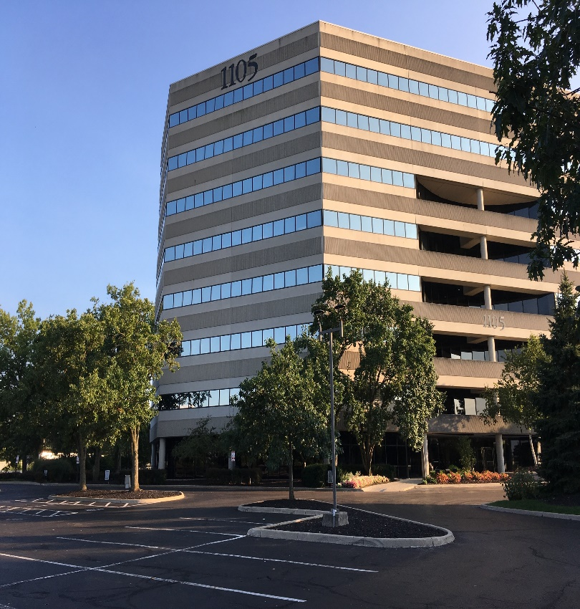
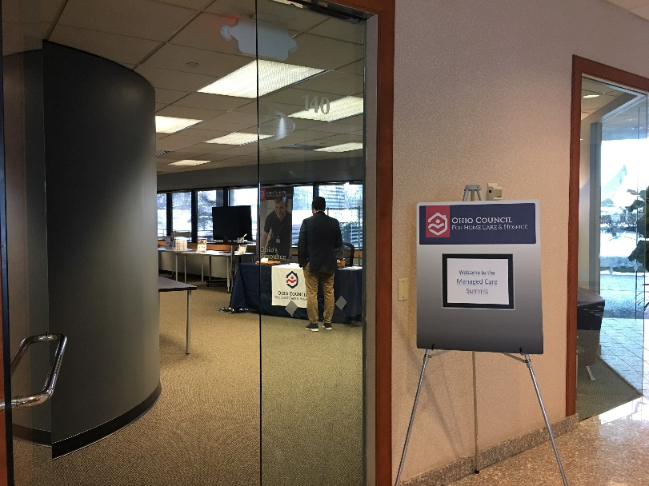
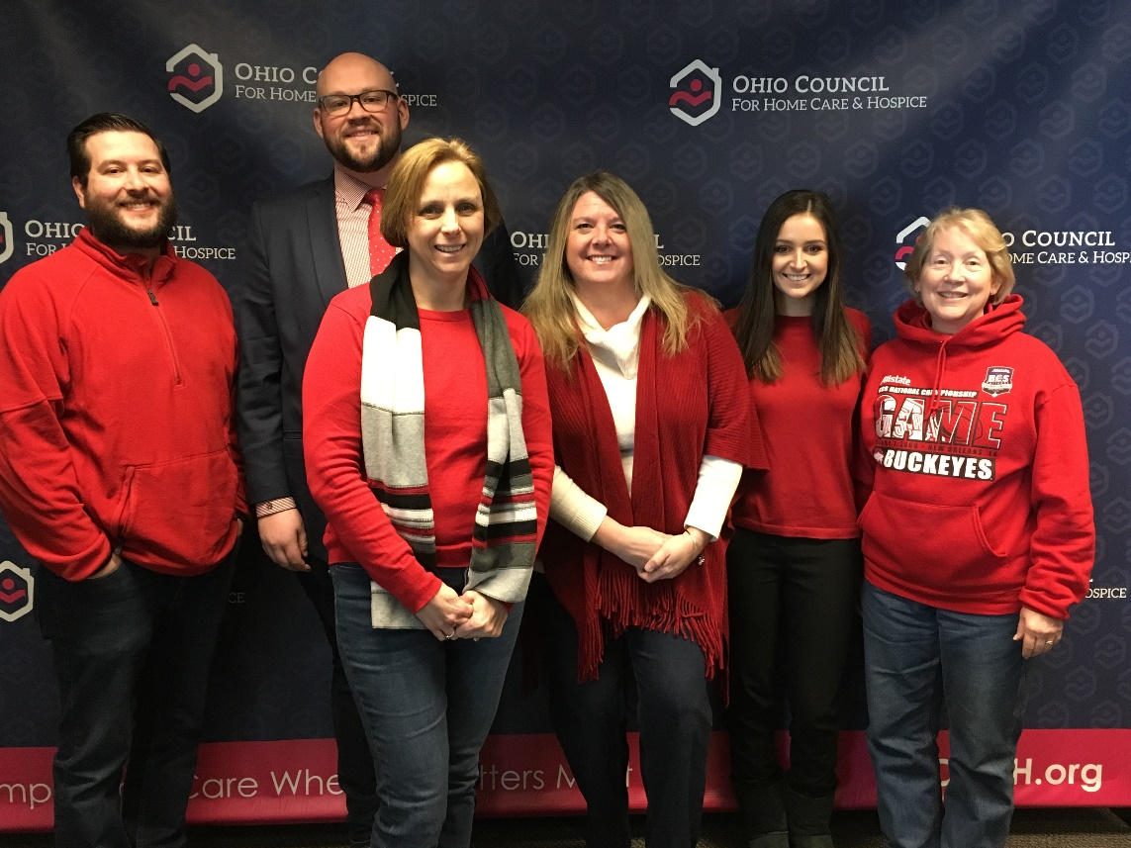
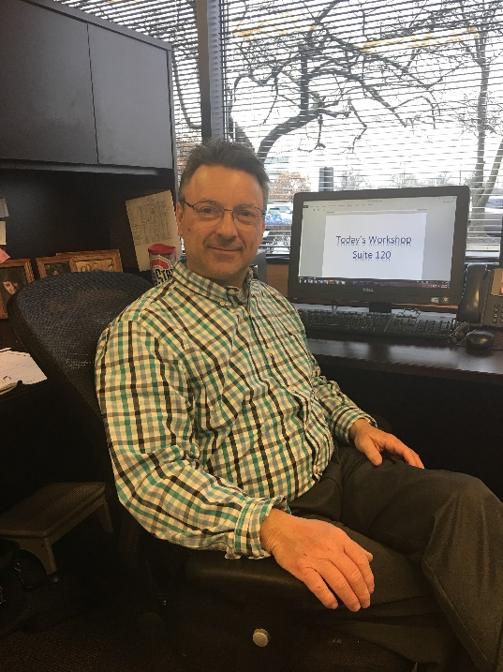
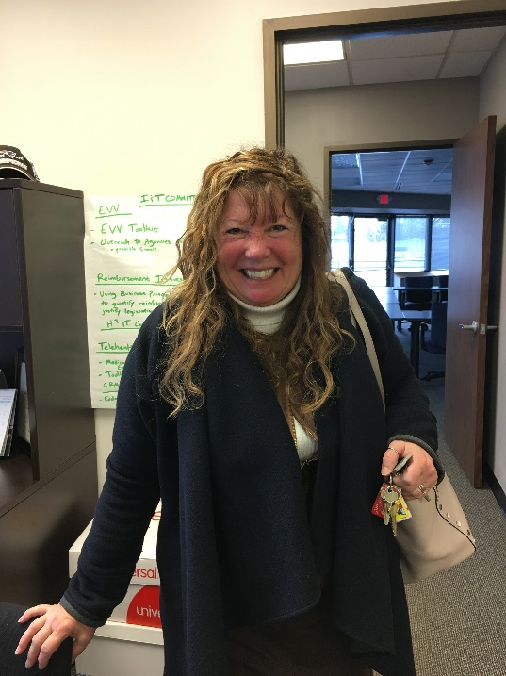
Professional experience at Ohio Council for
Home Care & Hospice
By Emma T. Hill, MSAH Administration
Goals
A Voice for the Community
Goal Outcomes
The primary goal is learning how to run a non-profit organization on a daily basis, with both short term and long term goals in mind, through observing and shadowing with Joe Russell, executive director of OCHCH.
Learning and understanding how OCHCH advocates for all of its members and non-members, by interacting with the various OCHCH members and affiliated organizations, and learning about the policies that impact them.
Interacting with and understanding third parties, such as sponsors, vendors, and other associated companies, to be able to comprehend how such parties function, relate, and support each other, as well as the community.
Learn how to build and oversee projects for OCHCH, such as workshops and webinars, to determine how these projects strengthen and benefit the various OCHCH members, non-members, and related organizations.
Develop leadership and management techniques that apply to a wide variety of healthcare settings, such as hospice and home-health agencies, as well as other community leadership positions.
The Ohio Council for Home Care & Hospice (OCHCH) was established in 1965 as a non-profit association to advocate for ethical, compassionate, quality home care and to provide members with a voice, value, and trusted resources (OCHCH, 2019).
OCHCH provides a wide variety of workshops as well as live and recorded webinars that allow members to keep pace with updates on important topics that includes billing, coding, OASIS, and many other key categories (OCHCH, 2019).
An important part of OCHCH is the political action committee (OCHCH-PAC) which helps member organizations unite their voice in government (OCHCH, 2019).
OCHCH holds Ohio’s largest gathering of home care and hospice professionals each year in the form of the OCHCH Annual Conference & Tradeshow, bringing together hundreds of exhibitors and attendees for a learning experience the supports improvements and partnerships (OCHCH, 2019).
Reference
Ohio Council for Home Care & Hospice (OCHCH) (2019). Center for Excellence. Retrieved February 23, 2019 from https://www.ochch.org/center-for-excellence/.
The OCHCH team has helped me to learn how they run a successful non-profit organization, how operations function each day. The mission was to understand how they achieve both short term and long term goals, by learning at Joe’s side. Attending meetings with Joe has shown me the importance of networking, of organizational and personal advancement, and adaptability. Good leaders make real-time decisions with long term goals in mind.
Just as leaders must be adaptable, so must healthcare organizations. OCHCH does more than lobby for home care and hospice organizations. Advocating goes beyond lobbying, it includes educating the members of OCHCH so that they can be their own voice, and provide them with the knowledge and chances to support their organizations and the industry.
Successful adapting means understanding industry partners and this happens through networking. It is important to be a good partner with vendors, sponsors, and other associated companies. I had many opportunities with Joe to learn many of the techniques for using that networking to allow OCHCH sponsors to connect with member organizations and build understanding.
This understanding and adaptability is why education is so important in this industry. By helping the team prepare for classes, seminars, and educational sessions, I was able to see how events and policy changes impact members and non-members in the home care and hospices industry, and how OCHCH helps them prepare for the unexpected.
Joe has helped me a lot in my journey to learn leadership and management strategies. Joe has shown me that networking is the most important skill a leader can have in healthcare today. This allows today’s healthcare leaders to organize, educate, prepare, and adapt in a rapidly growing and changing industry.
Learning from Leaders
Assisting Joe with research topics such as Ohio Family Stability Commission, Compound Annual Growth Rate, Home Care and Hospice Financial Managers Association (HHFMA), Alliance for Home Health Quality & Innovation, Medicare Rights Center, Malnutrition Prevention Commission, Home Health Prospective Payment System (HHPPS), Home Health Resource Groups (HHRG).
Attending and observing meetings, conferences calls, webinars, classes, and planning sessions to develop professional skills.
Developing and improving networking theory and techniques.
Improving leadership and communication skills by learning how to better serve the community.
Assisting Jim Godin, logistics director, with all the post-evaluation reports. These reports’ main purpose is for audits and to be able to improve future education.
Acknowledgement
Joe Russell – Site Supervisor, Executive Director of OCHCH
Dr. Paul Longenecker – MSAH Program Director
Otterbein University

