Slide 1
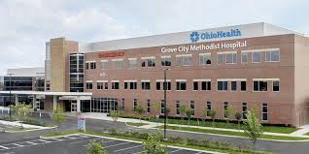
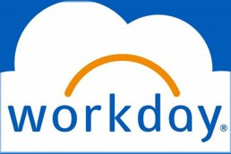
OhioHealth Grove City Methodist Hospital: Workday Implementation
James Eastep
My Goals
Results
Why Move to Workday
Goal 1: Understand the aspects of opening a new hospital from the administrative side.
Goal 2: Bring knowledge I have obtained during my master's program to help solve any potential problems that arise.
Goal 3: Take on a project of my own during my practicum time.
Goal 4: Improve my relationship and communication skills with other healthcare professionals
Goals 5: Network within OhioHealth
-Leading others can be challenging. Performing routine managerial task should be simple and easy to complete.
-OhioHealth leaders need direct access to information about their respective teams.
-OhioHealth current tools such as PeopleSoft, Fusion and Kronos do not meet these needs.
My project- Workday
My Role
-In charge of creating the leadership/implementation team.
-Create the presentation for the first implementation meeting.
-Present the first steps of the Workday implementation to the Grove City Methodist Hospital leadership team.
-Support the leadership team through the start of Workday implementation.
-Aided in mock Joint Commission surveys.
My Experience
Workday
-Attended a week long Workday leadership conference.
-Gained experience in building a productive working team within the work place.
-Gained experience in preparing to hold a leadership meeting.
-Presented Workday to the Grove City Methodist Hospital leadership team
_
Other Experiences
-Learned how to manage a hospital budget.
-Was able to understand and participate in Joint Commission preparation and mock surveys.
-Took part in daily administrative leadership rounds.
-Aided the COO and Operations Director with daily projects and task.
What is workday?
-An Enterprise Resource Planning (ERP) tool.
-This will be the new "PeopleSoft".
-The best in class solution. -Known for it's intuitive user experience.

