Slide 1
Increasing Fitness Engagement Among OhioHealth Employees
Kirsten Goins

Slide 2
Introduction
13-week practicum
OhioHealth Benefits & Wellness team
Two projects:
Increasing fitness class participation
Wellness kit for Westerville and Pickerington Medical Campuses

Slide 3
OhioHealth Background
As of May 2017, OhioHealth is made up of 29,000 associates, physicians, and volunteers
11 hospital and over 60 outpatient locations across 47 counties
OhioHealthy
Diabetes prevention/management
Weight management
Move & Improve
Health assessments
Biometric screening
Fitness rewards program
Tobacco cessation
Financial wellness

Slide 4
Fitness Class Engagement
Current on-site fitness classes:
Zumba at 180 E. Broad St.
Zumba at Marion Medical Campus
Zumba at Riverside Hospital
WERQ at Doctors Hospital

Slide 5
Fitness Class Engagement
Current marketing strategies
eBoards
Site contacts
eSource announcements
Virgin Pulse
New strategies
Posters displayed outside of fitness class rooms
Promotional postcard invites

Slide 6
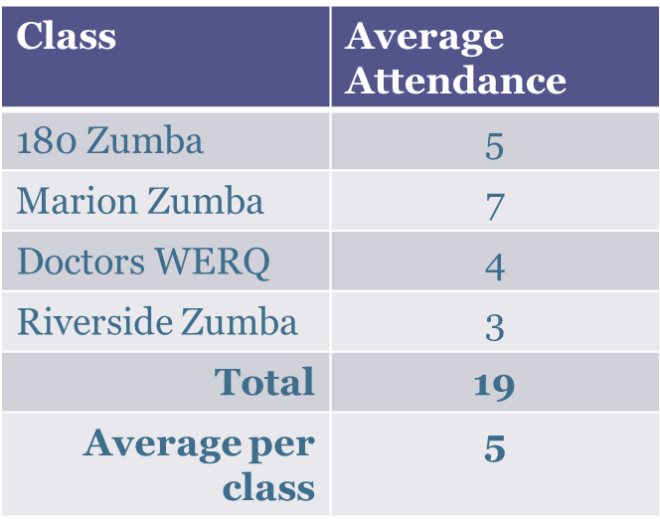
Fitness Class Engagement
Past Attendance
Goal
Increase the average attendance for group fitness classes by 40%
8 additional participants per week
About 2 per class

Slide 7
Fitness Class Engagement
Projected Timeline
Timing | Activity
11/1/17 | Display posters outside of fitness class rooms
11/6/17 | Postcards provided to all instructors
11/16/17 | Initial attendance evaluation
12/8/17 | Final attendance evaluation and recommendations

Slide 8
Fitness Class Engagement
Complications
1. Unable to display posters outside of rooms
2. Postcards relied on help from graphic designer
3. Requires cooperation from instructors
New Plan
Focus on postcards
“Bring a Friend” Days
Coordinate distribution and promotion plan with instructors

Slide 9
Fitness Class Engagement
Current State
No significant change in participation
Promotion is on-going, so no end data or long-term results are available at this time

Slide 10
Fitness Class Engagement
Limitations
Time
Length of practicum
Timing of promotion
No budget
Lack of access to HR share drive

Slide 11
Fitness Class Engagement
Fitness Class Surveys
Example:
Dublin Memorial Hospital
Number of Respondents: 32
Time Preference:
First Choice: 4:30 p.m. & 5:30 p.m. (tie)
Second Choice: 5:30 p.m.
Likelihood of Participating in an On-site Fitness Class
Not Likely | Somewhat Likely | Very Likely | Definitely
3% | 13% | 39% | 45%
Class Type | Percent of respondents who expressed interest
Dance-based | 59%
Yoga/Pilates | 59%
Strength/bootcamp | 50%
Walking Group | 28%

Slide 12
Wellness Kit
To provide tools that encourage wellness at smaller OhioHealth locations
Westerville and Pickerington Medical Campuses
Include resources such as:
Virgin Pulse demo
Educational workshops
Fitness/meditation DVDs
Walking paths
Wellness tip sheets

Slide 13
Wellness Kit
Walking Paths
Find safe, easy path that associates can use to be physically active
Measured distance, time, and steps
Overhead view of the campus with the highlighted route
Tips for success

Slide 14
Wellness Kit
Tip Sheets
5 Tips for physical activity, eating healthy, and stress
Example:
Increase your total steps for the day by making small changes that will be easy to accomplish.
Hold walking meetings.
Wear shoes that you will be comfortable in all day.
Hold a fitness class or walking group.
Utilize wearable activity trackers.

Slide 15
Recommendations
Utilize fitness survey results/feedback
Promotion and implementation of programs by Wellness Champions
New Associate Orientations
Offer combination classes (Durrett, 2004)
Use testimonials and recognize frequent participants (Monahan, 2014)
Virtual suggestion box (Kalahiki, 2015)

Slide 16
Questions?

Slide 17
References
Durrett, A. (2004). Trends in Corporate Fitness. IDEA Health and Fitness Association. Retrieved November 29, 2017 from http://www.ideafit.com/fitness-library/trends-incorpora-tefitnes-s
Kalahiki, L. (2015). 6 Steps to Effectively Communicate a Wellness Program to Employees. UHA Health Insurance. Retrieved November 29, 2017 from https://wellness.uhahealth.com/blog/well-being/6-steps-to-effectively-communicate-a-wellness-program-to-employees/
Monahan, D. (2014). Eight Tips for Increasing Wellness Program Engagement. Corporate Wellness Magazine. Retrieved November 29, 2017 from http://www.corporatewellnessmagazine.com/worksite-wellness/increasing-wellness-program-engagement/

